Slide 1
Unit 4: Relational Database Design
Kapil@nast.edu.np

Slide 2
Contents
Integrity constraints- Domain Constraints, Entity Integrity Constrains, Referential Integrity Constraints, Assertions and Triggers
Features of Good Relational Designs
Functional dependencies and Armstrong’s Axioms
Closure of a Set of Functional Dependencies and Closure of Attribute Sets
Database Normalization and Normal Forms- 1NF, 2NF, 3NF and BCNF
De-normalization for Performance
Notes:
Integrity constraints- Domain Constraints, Entity Integrity Constrains, Referential Integrity Constraints, Assertions and Triggers
Features of Good Relational Designs
Functional dependencies and Armstrong’s Axioms
Closure of a Set of Functional Dependencies and Closure of Attribute Sets
Database Normalization and Normal Forms- 1NF, 2NF, 3NF and BCNF
De-normalization for Performance

Slide 3
What is Relational Database Design?
Relational database design is the process of organizing data into relations (tables) to:
Reduce redundancy
Improve consistency
Ensure data integrity
Simplify data retrieval
Maintain relationships among data
A well-designed database stores data efficiently and avoids duplication.
Roll No | Name | Address
101 | Ram | Kathmandu
102 | Sita | Pokhara

Slide 4
Integrity Constraints
Integrity constraints are rules that ensure:
Accuracy
Consistency
Validity
Reliability of data
of data stored in a database.
They prevent the insertion of incorrect, inconsistent, or duplicate data into database tables.
Types:
Domain Constraints
Entity Integrity Constraints
Referential Integrity Constraints
Assertions
Triggers
Notes:
Integrity constraints are rules that maintain the correctness and consistency of data stored in a database.

Slide 5
Why is Integrity Constraints Important?
Roll_No | Name | Age
101 | Ram | 20
NULL | Sita | 19
101 | Hari | 21
Problems:
Primary key is NULL.
Duplicate Roll_No exists.
Data becomes unreliable.
Integrity constraints prevent such situations.
Benefits
Maintains data accuracy
Ensures consistency
Reduces redundancy
Prevents invalid entries
Preserves relationships between tables

Slide 6
Domain Integrity Constraints
A domain constraint specifies the permissible values that can be stored in an attribute.
They serve as the most fundamental type of integrity constraint to ensure
data accuracy,
completeness,
Validity
Consistency
Database reliability
Reduce application errors
Any data entry or modification violating these rules is automatically rejected by the system
Core Requirement of Domain Constraints
Atomicity: Values must be indivisible or atomic units
Data Type compliance : Every value must match the predetermined system data type
Notes:
A domain constraint is a database rule that restricts the values that can be stored in an attribute to a predefined set, range, format, or data type. It ensures that only valid and meaningful data is entered into the database.
In other words, a domain constraint defines the valid range, type, format, and permissible values for an attribute.
Core Requirements of Domain Constraints
Atomicity: Values must be indivisible or atomic units. Composite or multi-valued entries (like storing two phone numbers or a full address in a single field) violate domain constraints.
Data Type Compliance: Every value must match the predetermined system data type (e.g., INT, VARCHAR, DATE) assigned to that specific column.
Primary Types of Domain Constraints
The database management system enforces specific attributes using a combination of data types and explicit constraints:
Data Type Declarations: Formally defines the category of data. Setting an Age attribute to INT blocks any character string input.
NOT NULL: Prevents a column from accepting empty or missing values. Essential fields like customer_name or employee_id rely on this to maintain completeness.
CHECK Constraints: Limits values across specific ranges or sets using a condition. For instance, restricting an Age column to only accept integers between 18 and 65 (CHECK (Age BETWEEN 18 AND 65)).
UNIQUE: Ensures all values within the specified column are completely distinct from one another, preventing duplicate records.
DEFAULT: Automatically populates a predefined value if the user provides no explicit entry during a row insertion.
Implementing Domain Constraints in SQL
Developers can view and implement domain constraints directly via SQL syntax during table definition. The following technical structure shows how domain restrictions are mapped to attributes

Slide 7
Primary Types of Domain Constraints
The database management system enforces specific attributes using a combination of data types and explicit constraints:
Data Type Declaration: Specifies the kind of value.
NOT NULL: A domain may prohibit missing values.
CHECK: Restricts values within a specified interval.
UNIQUE: Unique Values i.e no repitiotion
DEFAULT: Gives a default value
Notes:
1. 1. Data Type: Specifies the kind of value.
Examples:
Age INT Name VARCHAR(50) Salary DECIMAL(10,2)
Valid:
Age = 25
Invalid:
Age = 'Twenty Five'
2. Range of Values: Restricts values within a specified interval.
Example:
Age INT CHECK(Age BETWEEN 18 AND 60)
Valid:
18 25 60
Invalid:
10 75
3. Set of Allowed Values: Only predefined values are accepted.
Example:
Gender VARCHAR(10) CHECK(Gender IN ('Male','Female','Other'))
Valid:
Male Female Other
Invalid:
M Boy Unknown
4. Format Restrictions: Values must follow a specific pattern.
Example:
Phone number should contain exactly 10 digits.
Phone CHAR(10)
Possible validation:
CHECK(LENGTH(Phone)=10)
5. NULL Restrictions: A domain may prohibit missing values.
Example:
Name VARCHAR(50) NOT NULL
Valid:
Ram
Invalid:
NULL

Slide 8
Implementing Domain Constraints
CREATE TABLE Employees (
EmployeeID INT PRIMARY KEY,
FirstName VARCHAR(50) NOT NULL, -- Restricts null entries
Age INT CHECK (Age >= 18 AND Age <= 65), -- Restricts values to a specific range
Email VARCHAR(100) UNIQUE, -- Enforces unique attribute values
Country VARCHAR(50) DEFAULT ‘Nepal' -- Standard default assignment
);
INSERT INTO Employees
VALUES(102,'Hari',15,’hari@gmail.com’, ‘Japan’);
INSERT INTO Employees
VALUES(101,'Ram',21,’Ram@gmail.com');
Which one is valid?
Notes:
AttributeDomainRoll_NoPositive IntegerNameMaximum 50 CharactersSemester1–8CGPA0–4EmailValid Email Format
CREATE TABLE Student(
Roll_No INT,
Name VARCHAR(50),
Semester INT CHECK(Semester BETWEEN 1 AND 8),
CGPA DECIMAL(3,2)
CHECK(CGPA BETWEEN 0 AND 4)
);

Slide 9
Advantages
1. Improved Data Quality
Only valid values are stored.
2. Better Consistency
Data follows predefined rules.
3. Reduced Errors
Prevents accidental incorrect entries.
4. Easier Data Validation
Database automatically checks values.
5. Increased Reliability
Reports and analysis become more accurate.
Not all Complex business can enforce solely by Domain Constraints, they need
Triggers
Procedures
Assertions

Slide 10
Entity Integrity Constraint
Entity Integrity Constraint is a rule that ensures that every row (tuple) in a table can be uniquely identified but cannot contain any NULL values.
Entity Integrity is enforced through the Primary Key.
Formal Definition:
For any relation R having a primary key PK:
Primary Key values must be unique.
Primary Key values cannot be NULL.
No two tuples can have the same primary key value.
Why Entity Integrity Matters?
Implementing these constraints provides critical foundational benefits to database management:
Unique Identification
Elimination of Duplicates
Enables Relationships:
Notes:
An Entity Integrity Constraint is a fundamental rule in a Database Management System (DBMS) stating that the primary key of a table must be entirely unique and cannot contain any NULL values. Because a primary key uniquely identifies individual rows (entities) in a relational table, a NULL or duplicate entry would make it impossible for the database to accurately locate or distinguish specific records
Core Requirements
To satisfy entity integrity, the designated primary key column(s) must meet two strict conditions
Uniqueness: No two rows in the table can share the exact same primary key value.
NOT NULL Property: The primary key field cannot be left blank or contain NULL, as a missing value cannot serve as a reliable identifier
Why Entity Integrity Matters
Implementing these constraints provides critical foundational benefits to database management: [1, 2]
Unique Identification: Guarantees a reliable method to fetch, update, or delete any specific record without affecting other rows.
Elimination of Duplicates: Prevents redundant data entries, ensuring the overall database remains clean and trustworthy.
Enables Relationships: Serves as the foundation for referential integrity, since foreign keys in other tables rely on a stable, predictable primary key to link data accurately

Slide 11
Valid vs InValid Data
StudentID | StudentName | Course | Status
101 | Ram | Computer Science | Valid: Unique and non-null.
102 | Shyam | Mathematics | Valid: Unique and non-null.
101 | Hari | Mathematics | Invalid: Violates uniqueness (Duplicate ID).
NULL | Om | Chemistry | Invalid: Violates NOT NULL restriction.
CREATE TABLE Students (
StudentID INT PRIMARY KEY,
StudentName VARCHAR(50) NOT NULL,
Course VARCHAR(50)
);

Slide 12
Entity Integrity | Domain Integrity | Referential Integrity
Ensures row identification | Ensures valid values | Maintains relationships
Uses Primary Key | Uses Data Type, CHECK | Uses Foreign Key
No NULL in PK | Valid domain values | Works between tables
Prevents duplicate records | Prevents invalid entries | Prevents invalid references

Slide 13
Referential Integrity Constraint
Referential Integrity Constraint is a rule that ensures consistency between related tables in a database.
Maintains consistency between related tables.
A Foreign Key value in one table must either match an existing Primary Key value in the referenced table or be NULL (if allowed).
Core Components: Referential integrity works by binding two specific columns across two distinct tables:
Parent Table (Referenced Table): Contains the primary key
Child Table (Referencing Table): Contains the foreign key that points back to the parent table's primary key
Notes:
This constraint maintains valid relationships between tables and prevents the existence of invalid references.

Slide 14
Example:
Dept_ID | Dept_Name
D1 | BCA
D2 | BBA
D3 | Civil
Roll_No | Name | Dept_ID | Status
101 | Ram | D1 | Valid: Matches BCA
102 | Sita | D2 | Valid: Matches BBA
103 | Lanka | NULL | Valid can be null
104 | Hari | D4 | Violated & Rejected ( Dept D4 does not exist)
Creating Parent table: CREATE TABLE Department(
Dept_ID VARCHAR(5) PRIMARY KEY,
Dept_Name VARCHAR(30)
);
Creating Child table: CREATE TABLE Student(
Roll_No INT PRIMARY KEY,
Name VARCHAR(50),
Dept_ID VARCHAR(5),
FOREIGN KEY (Dept_ID)
REFERENCES Department(Dept_ID)
);

Slide 15
Violations and Handling Violations
DBMS automatically monitors data modifications to intercept actions that break this constraint. So, the following Operations that can violate Referential Integrity:
Insert (on Child Table)
Update (on Child Table)
Delete (on Parent Table)
Update (on Parent Table
We can Handle that by:
RESTRICT / NO ACTION (Default : ON DELETE RESTRICT
CASCADE : ON DELETE CASCADE Or ON UPDATE CASCADE
SET NULL : ON DELETE SET NULL
SET DEFAULT : ON DELETE SET DEFAULT
What are Orphan Records?
Notes:
A Database Management System (DBMS) automatically monitors data modifications to intercept actions that break this constraint:
Insert (on Child Table): Trying to add an order with a Customer_ID that does not exist in the parent table.
Update (on Child Table): Modifying a foreign key value to something that does not exist in the parent table.
Delete (on Parent Table): Deleting a customer who already has orders linked to their ID.
Update (on Parent Table): Altering a customer's primary key while child rows are actively pointing to it.
Handling Violations: Cascading Actions [1]
When a user tries to modify or delete a primary key in a parent table, the database can handle the dependent child records using specific rules:
RESTRICT / NO ACTION (Default): The DBMS completely rejects the deletion or update of the parent row until the dependent child rows are manually deleted or altered first.
CASCADE (ON DELETE CASCADE / ON UPDATE CASCADE): If a parent row is deleted or modified, all corresponding rows in the child table are automatically deleted or modified alongside it.
Sql : FOREIGN KEY(Dept_ID) REFERENCES Department(Dept_ID) ON UPDATE CASCADE
SET NULL: If a parent row is deleted, the matching foreign key fields in the child rows are immediately wiped and set to NULL.
SET DEFAULT: If a parent row is deleted, the foreign key fields in the child rows revert to a predefined default value.

Slide 16
Advantages
Maintains Consistency
Related tables remain synchronized.
Prevents Invalid References
Foreign keys must point to existing records.
Eliminates Orphan Records
Every child record has a valid parent.
Improves Data Accuracy
Relationships remain meaningful.
Supports Reliable Queries
Joins produce correct results.

Slide 17
Assertions
Assertions are conditions that must always remain true for the entire database.
In other words, An Assertion is a condition that the database must always satisfy. If any operation (INSERT, UPDATE, DELETE) violates the condition, the operation is rejected.
Characteristics
Apply to one or more tables
Enforce business rules
Checked whenever data changes
Notes:
Unlike constraints such as PRIMARY KEY, FOREIGN KEY, or CHECK, which are applied to a specific table or column, an assertion can involve multiple tables and enforce complex business rules.
CREATE ASSERTION Age_Check
CHECK(
NOT EXISTS(
SELECT *
FROM Student
WHERE Age < 18
)
);
Maintains global database consistency.

Slide 18
Why do we need Assertion?
Many real-world business rules cannot be enforced using simple constraints.
Example
In a university:
A student must be at least 18 years old.
A department cannot have more than 100 students.
Total allocated project budget should not exceed the available budget.
These rules may involve multiple rows or multiple tables.
Whenever data is: Inserted, Updated , Deleted , the DBMS checks the assertion condition.
If Condition is TRUE : Operation succeeds
If Condition is FALSE : Operation is rejected

Slide 19
Example:
CREATE ASSERTION assertion_name // Creates new assertion with name Assertion_name
CHECK (condition); //check for condition = rule that must always be true
CREATE ASSERTION Student_Age_Check
CHECK (
NOT EXISTS(
SELECT *
FROM Student
WHERE Age < 18
)
);
Roll_No | Name | Age
101 | Ram | 20
102 | Sita | 22
- What happens when you search?
SELECT *
FROM Student
WHERE Age < 18;
- What happens when you insert?
INSERT INTO Student
VALUES(103,'Hari',16);
Notes:
Query
SELECT * FROM Student WHERE Age < 18
Finds students younger than 18.
NOT EXISTS
Means:
"There should be no such students."
If a student aged 16 is inserted:
INSERT INTO Student VALUES(103,'Hari',16);
The assertion becomes FALSE.
Result:
❌ Insertion rejected.
Example 2: Department Capacity
Suppose a department can have a maximum of 100 students.
CREATE ASSERTION Max_Students
CHECK (
NOT EXISTS(
SELECT Dept_ID
FROM Student
GROUP BY Dept_ID
HAVING COUNT(*) > 100
)
);
Explanation
The assertion checks:
Count students in each department.
If any department has more than 100 students, the assertion fails.
Result:
❌ Further insertions are blocked.
t
Example 3: Salary Rule
Business Rule:
No employee should have a salary less than Rs. 15,000.
CREATE ASSERTION Salary_Check CHECK( NOT EXISTS( SELECT * FROM Employee WHERE Salary < 15000 ) );
Valid Data
Emp_ID Salary
101 25000
102 30000
Invalid Data
Emp_ID Salary
103 10000
Result:
❌ Rejected
Example 4: Bank Balance Rule
Rule:
Every account balance must remain positive.
CREATE ASSERTION Positive_Balance CHECK( NOT EXISTS( SELECT * FROM Account WHERE Balance < 0 ) );
Valid
Account_No Balance
A101 5000
A102 10000
Invalid
Account_No Balance
A103 -500
Result:
❌ Transaction rejected

Slide 20
Across Multiple Tables
One major advantage of assertions is that they can involve multiple tables.
Project_ID | Dept_ID | Cost
P1 | D1 | 200000
P2 | D1 | 250000
CREATE ASSERTION Budget_Check
CHECK(
NOT EXISTS(
SELECT Dept_ID
FROM Project
GROUP BY Dept_ID
HAVING SUM(Cost) >
(
SELECT Budget
FROM Department
WHERE Department.Dept_ID = Project.Dept_ID
)));
Dept_ID | Budget
D1 | 500000
Let us take an example, we have two table: and we need to make a rule that; Total cost of the project must not exceed department budget.
Notes:
What it Means
"There should NOT exist any department whose total project cost exceeds its budget."
Total Project Cost = 450000
Budget = 500000
Since:
450000 ≤ 500000
✅ Condition satisfied
If another project is added:
Project_ID Dept_ID Cost
P3 D1 100000
Total Cost = 200000 + 250000 + 100000 = 550000
Now:
550000 > 500000
❌ Assertion fails
CREATE ASSERTION Budget_Check
CHECK(
NOT EXISTS(
SELECT *
FROM Department D
WHERE D.Budget <
(
SELECT SUM(P.Cost)
FROM Project P
WHERE P.Dept_ID = D.Dept_ID
)
)
);
Why use Assertion here instead of CHECK?"
Answer:
Because the rule involves multiple rows (SUM of costs) and two tables (Project and Department). A CHECK constraint can only validate individual row values, whereas an ASSERTION can validate conditions involving multiple rows and tables.

Slide 21
Advantages Limitations
Enforce Complex Business Rules
Can express conditions involving many tables.
Improve Data Integrity
Ensures database remains consistent.
Centralized Validation
Rules are stored in one place.
Database Independence
Validation remains in database rather than application code.
Better Reliability
Invalid transactions are automatically rejected.
Performance Overhead
Complex assertions may be expensive to check.
Limited DBMS Support
Many modern DBMSs (including MySQL)
do not fully support CREATE ASSERTION.
Difficult to Maintain
Large assertions can become complex.
Often Replaced by Triggers
Many databases use triggers instead.

Slide 22
Real-World Applications of Assertions
University System
Maximum students per class
Minimum CGPA requirements
Banking System
Account balance must remain positive
Daily withdrawal limit
Hospital System
Doctor workload limits
Room occupancy limits
Airline Reservation System
Seat bookings cannot exceed available seats
Rule: A semester should not contain more than 60 students.
SQL:
CREATE ASSERTION Semester_Limit
CHECK(
NOT EXISTS(
SELECT Semester
FROM Student
GROUP BY Semester
HAVING COUNT(*) > 60
)
);
This means every semester must have count less than 60

Slide 23
BUT…..….. Assertion are Theoretical
In Practice
Most popular DBMSs do not implement CREATE ASSERTION.
Because assertions can be expensive to check whenever any related table changes
They are intended to enforce database-wide rules such as:
Maximum 100 students per department
Total project cost ≤ department budget
Total salary expense ≤ company budget
So, from a relational database theory perspective, assertions are a valid and important concept.
CHECK, TRIGGERS and,Stored Procedures are used instead.
DBMS | Assertion Support
MySQL | ❌ No
MariaDB | ❌ No
PostgreSQL | ❌ No
SQL Server | ❌ No
Oracle | ❌ No
Notes:
What is Used Instead?
In real projects, developers use:
1. CHECK Constraints
For simple row-level rules.
Age >= 18 Salary > 0 CGPA <= 4
2. Triggers
For complex business rules.
Example:
Maximum 100 students per department
implemented through a BEFORE INSERT trigger.
3. Stored Procedures / Application Logic
Sometimes validation is performed in:
Java
Python
PHP
Django
.NET
before data reaches the database.
Assertions are database-level integrity constraints used to enforce conditions involving multiple rows or tables. Although they are part of the SQL standard, most modern DBMSs do not support them directly. In practical systems, triggers and application logic are commonly used to achieve the same functionality.
For Exams
You should still study Assertions because:
They are part of the relational model and SQL standard.
Universities (including DBMS courses like Pokhara University) ask them in theory exams.
They explain why triggers are needed in practice.

Slide 24
TRIGGERS
A Trigger is a special stored procedure that automatically executes (fires) when a specified event occurs on a table or view.
Trigger Events
INSERT
UPDATE
DELETE
Why are Triggers Needed?
Enforce complex business rules
Maintain data integrity
Keep audit logs
Automatically update related tables
Validate data before insertion
SQL:
CREATE TRIGGER trigger_name
[BEFORE | AFTER] [INSERT | UPDATE | DELETE]
ON table_name
FOR EACH ROW
BEGIN
-- SQL execution logic goes here
END;
Notes:
A Trigger is a database action that automatically runs in response to changes made to data.
Types of Triggers
Based on timing:
BEFORE Trigger
AFTER Trigger
Based on event:
INSERT Trigger
UPDATE Trigger
DELETE Trigger
Real-Life Example
Suppose a bank has an Account table.
If money is withdrawn, the bank wants to record the transaction in a log table automatically.
Instead of asking programmers to write code every time, a trigger can do it automatically.

Slide 25
Classification of Triggers
Database engines group triggers based on what operation initiates them, when they execute, and how many times they run.
By the Firing Operation
DML Triggers: INSERT, UPDATE, and DELETE.
DDL Triggers:. CREATE, ALTER, or DROP.
Logon Triggers: user session or connection is established with the database server
By Firing Time
BEFORE Triggers: Run prior to executing the triggering data
AFTER Triggers: Execute only after operation
INSTEAD OF Triggers: Intercept the requested action completely and replace it with custom SQL logic
By Firing Frequency (Granularity)
Row-Level Triggers: Execute independently for every individual row
Statement-Level Triggers: statement modifies zero rows, one row, or millions of rows simultaneously
Notes:
By the Firing Operation
DML Triggers: Fire in response to Data Manipulation Language events like INSERT, UPDATE, and DELETE.
DDL Triggers: Execute during Data Definition Language structural changes like CREATE, ALTER, or DROP.
Logon Triggers: Activate when a user session or connection is established with the database server.
2. By Firing Time
BEFORE Triggers: Run prior to executing the triggering data change. These are ideal for validating or formatting data before it is permanently saved.
AFTER Triggers: Execute only after the primary database operation completes successfully. These are widely used to maintain historical logs or cascade changes to unrelated tables.
INSTEAD OF Triggers: Intercept the requested action completely and replace it with custom SQL logic. These are highly critical for allowing updates on non-updatable complex views.
3. By Firing Frequency (Granularity)
Row-Level Triggers: Execute independently for every individual row affected by an SQL statement. They use pseudo-records like NEW and OLD to capture runtime column data values.
Statement-Level Triggers: Execute exactly once per SQL statement, regardless of whether that statement modifies zero rows, one row, or millions of rows simultaneously

Slide 26
Types of Triggers
Based on timing:
BEFORE Trigger
AFTER Trigger
Based on event:
INSERT Trigger
UPDATE Trigger
DELETE Trigger
Notes:
BEFORE INSERT Trigger
Purpose
Validates data before insertion.
Example
Prevent students younger than 18 from being inserted.
CREATE TRIGGER Check_Age BEFORE INSERT ON Student FOR EACH ROW BEGIN IF NEW.Age < 18 THEN SIGNAL SQLSTATE '45000' SET MESSAGE_TEXT='Age must be 18 or above'; END IF; END;
What Happens?
Attempt:
INSERT INTO Student VALUES(101,'Ram',16);
Trigger fires:
16 < 18
Result:
❌ Insert rejected
AFTER INSERT Trigger
Purpose
Perform actions after insertion.
Example
Audit logging.
Student Table
Roll_NoName101Ram
Audit Table
ActionStudent Added
Trigger:
CREATE TRIGGER Student_Log AFTER INSERT ON Student FOR EACH ROW BEGIN INSERT INTO Audit_Log VALUES('Student Added'); END;
What Happens?
INSERT INTO Student VALUES(101,'Ram');
Result:
Student
Roll_NoName101Ram
Audit_Log
ActionStudent Added
Automatically inserted.
BEFORE UPDATE Trigger
Purpose
Validate updates before they occur.
Example:
Salary cannot be reduced below 15000.
CREATE TRIGGER Check_Salary BEFORE UPDATE ON Employee FOR EACH ROW BEGIN IF NEW.Salary < 15000 THEN SIGNAL SQLSTATE '45000' SET MESSAGE_TEXT='Salary too low'; END IF; END;
AFTER UPDATE Trigger
Purpose
Record changes after updates.
Example:
Track salary changes.
CREATE TRIGGER Salary_Audit AFTER UPDATE ON Employee FOR EACH ROW BEGIN INSERT INTO Salary_Log VALUES( OLD.Salary, NEW.Salary ); END;
BEFORE DELETE Trigger
Purpose
Prevent deletion under certain conditions.
Example:
Do not allow deletion of admin users.
CREATE TRIGGER Prevent_Admin_Delete BEFORE DELETE ON Users FOR EACH ROW BEGIN IF OLD.Role='Admin' THEN SIGNAL SQLSTATE '45000' SET MESSAGE_TEXT='Cannot delete admin'; END IF; END;
AFTER DELETE Trigger
Purpose
Maintain deletion history.
CREATE TRIGGER Delete_Log AFTER DELETE ON Student FOR EACH ROW BEGIN INSERT INTO Deleted_Students VALUES( OLD.Roll_No, OLD.Name ); END;

Slide 27
OLD and NEW Keywords
NEW: Represents the new data.
Udes in INSERT and UPDATE,
OLD: Represents existing data before change.
Used in UPDATE and DELETE
Example: Now we try to update data;
UPDATE Employee
SET Salary=40000
WHERE Emp_ID=101;
Before Update
Emp_ID | Salary
101 | 30000
After Update: Inside trigger we can see:
Old. SALARY = 30000
NEW.Salary = 40000

Slide 28
Example: Maximum 100 Students per Department.
CREATE TRIGGER Check_Department_Limit
BEFORE INSERT
ON Student
FOR EACH ROW
BEGIN
IF(
SELECT COUNT(*)
FROM Student
WHERE Dept_ID=NEW.Dept_ID
) >=100
THEN
SIGNAL SQLSTATE '45000'
SET MESSAGE_TEXT=
'Department Full';
END IF;
END;
Let there are 100 students in BCA department.
We try to insert:
INSERT INTO Student
VALUES(501,'Hari','BCA’);
Triggers fires for count = 101, then Insertion is blocked and output comes as Department full.
ASSERTION EQUIVALENT CODE:
CREATE ASSERTION Max_Students
CHECK(
COUNT(*) <=100
);

Slide 29
Example
Prevent deletion of all students.
CREATE TRIGGER Prevent_Delete
BEFORE DELETE
ON Student
FOR EACH ROW
BEGIN
SIGNAL SQLSTATE '45000'
SET MESSAGE_TEXT='Deletion Not Allowed';
END;

Slide 30
Advantages Limitations
Automatic Execution
No manual intervention required.
Enforces Business Rules
Can implement complex constraints.
Maintains Data Integrity
Ensures consistency.
Audit Logging
Tracks inserts, updates, deletions.
Security
Can prevent unauthorized actions
Hidden Logic
Triggers execute automatically and may be difficult to notice.
Performance Overhead
Too many triggers can slow down operations.
Difficult Debugging
Errors may be harder to trace.
Complex Maintenance
Large systems may contain many triggers.

Slide 31
Features of Good Relational Designs
A good database design should:
Minimize redundancy
Avoid update anomalies
Ensure consistency
Support data integrity
Facilitate efficient queries
Be easy to maintain
Notes:
Minimize Data Redundancy
Data Redundancy
Repeated storage of the same information.
Bad Design
Student Dept Dept_HOD
Ram BCA Sharma
Sita BCA Sharma
"HOD" is repeated.
Better Design
Separate Department table.
Benefits:
Less storage
Easier updates
Avoid Update Anomalies
Modification Anomaly
Changing a value requires updates in multiple rows.
Example
HOD changes from Sharma to Karki.
Need to update every BCA record.
Good Design
Store HOD information once in Department table.
Avoid Insertion Anomalies
Problem
Cannot insert department unless a student exists.
Example
Cannot add:
Dept_ID Dept_Name
D3 Civil
if stored only within Student table.
Solution
Separate tables.
Avoid Deletion Anomalies
Problem
Deleting a record causes unintended loss of information.
Example:
Deleting last BCA student removes department information.
Solution
Normalize tables.
Consistency and Integrity
Good design ensures:
✔ Accurate data
✔ Consistent relationships
✔ Valid references
✔ Reliable reporting

Slide 32
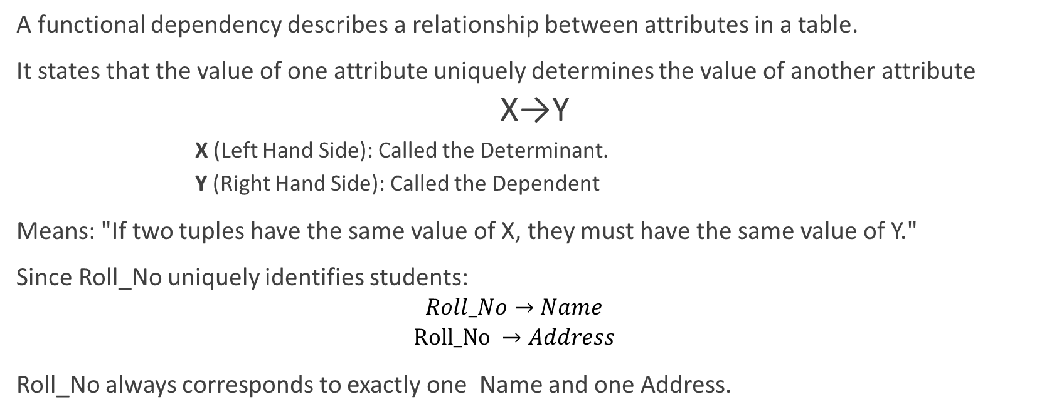
Functional dependencies
A functional dependency describes a relationship between attributes in a table.
It states that the value of one attribute uniquely determines the value of another attribute
X→Y
X (Left Hand Side): Called the Determinant.
Y (Right Hand Side): Called the Dependent
Means: "If two tuples have the same value of X, they must have the same value of Y."
Since Roll_No uniquely identifies students:
$$Roll_No→Name$$
$$Roll_No →Address$$
Roll_No always corresponds to exactly one Name and one Address.
Roll_no | Name | Address
101 | Ram | Kathmandu
102 | Sita | Pokhara
101 | Ram | Kathmandu
Notes:
Determinant (X): The attribute(s) on the left side.
Dependent (Y): The attribute(s) on the right side.
Functional dependencies describe constraints in the data.
Types of Functional Dependencies
Non-Trivial Dependency
Dependency where:
$$Y⊈X$$
Example:
$$RollNo→Name$$
Name is not part of RollNo.
Fully Functional Dependency
Attribute depends on the whole key.
Example:
$$\left(S , tudentIDCourseID\right)→Grade$$
Grade depends on both attributes.
Partial Dependency
Attribute depends on part of a composite key.
Example:
$$\left(S , tudentIDCourseID\right)→StudentName$$
StudentName depends only on StudentID.
This leads to redundancy.
Transitive Dependency
When:
$$A→B$$
and
$$B→C$$
then
$$A→C$$
Example:
$$StudentID→DeptID$$
$$DeptID→DeptName$$
Therefore:
$$StudentID→DeptName$$

Slide 33
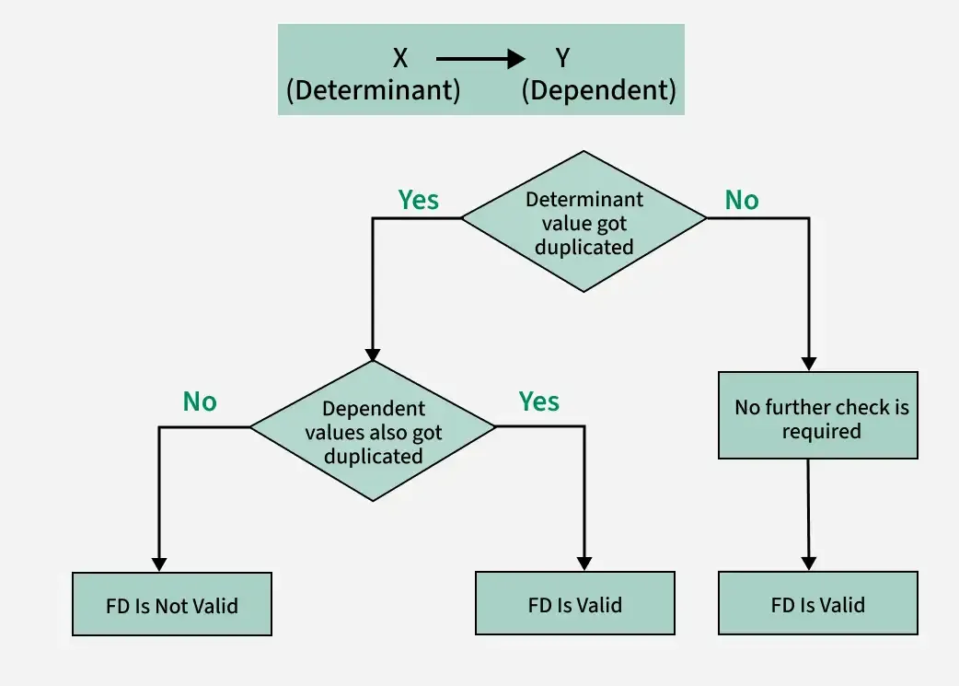

Slide 34
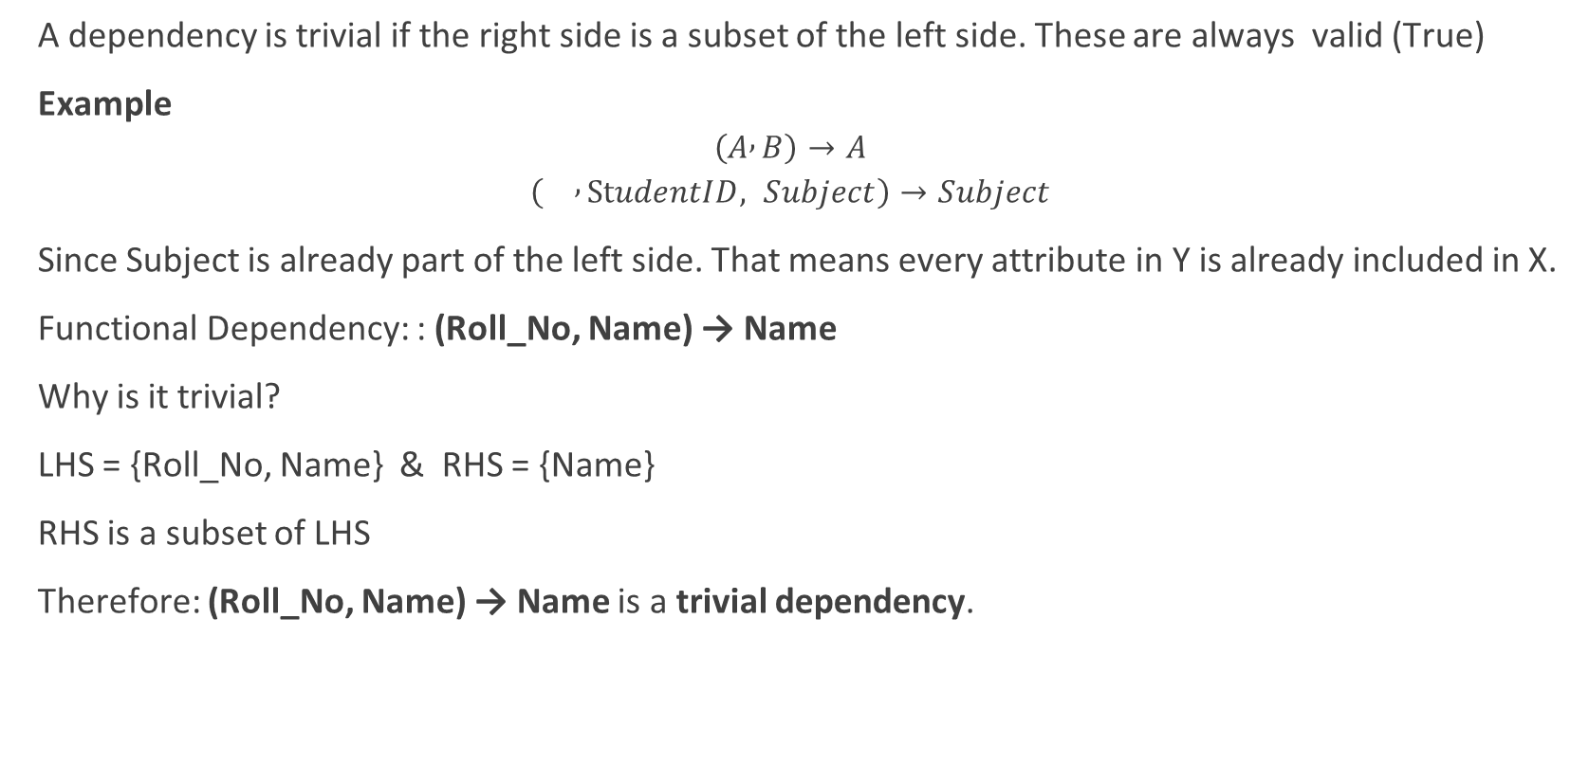
Trivial Functional Dependencies
A dependency is trivial if the right side is a subset of the left side. These are always valid (True)
Example
$$\left(A , B\right)→A$$
$$\left( , StudentID, Subject\right)→Subject$$
Since Subject is already part of the left side. That means every attribute in Y is already included in X.
Functional Dependency: : (Roll_No, Name) → Name
Why is it trivial?
LHS = {Roll_No, Name} & RHS = {Name}
RHS is a subset of LHS
Therefore: (Roll_No, Name) → Name is a trivial dependency.
Roll_No | Name | Department
101 | Ram | BCA
102 | Shyam | BBA
Notes:
Example 2
Consider:
(Student_ID, Subject_ID) → Student_ID
LHS = {Student_ID, Subject_ID}
RHS = {Student_ID}
Since Student_ID already exists on the left side, it is a trivial dependency.
Example 3
(A, B, C) → (A, C)
RHS = {A, C}
RHS is completely contained in LHS
Therefore it is a trivial dependency.
Why Is It Called "Trivial"?
Because it is always true by definition.
If you already know:
Roll_No = 101
Name = Ram
Then asking for Name from (Roll_No, Name) doesn't provide any new information.

Slide 35
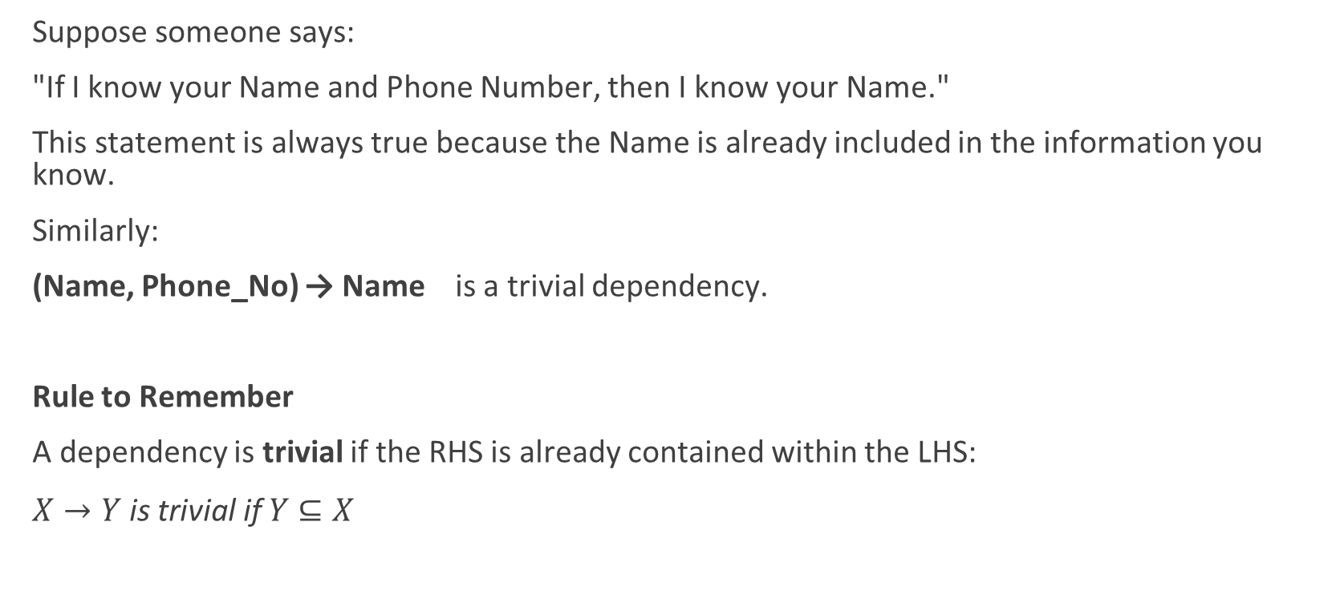
Trivial logic
Suppose someone says:
"If I know your Name and Phone Number, then I know your Name."
This statement is always true because the Name is already included in the information you know.
Similarly:
(Name, Phone_No) → Name is a trivial dependency.
Rule to Remember
A dependency is trivial if the RHS is already contained within the LHS:
$X→Y \text{is} \text{trivial} \text{if} Y⊆X$

Slide 36
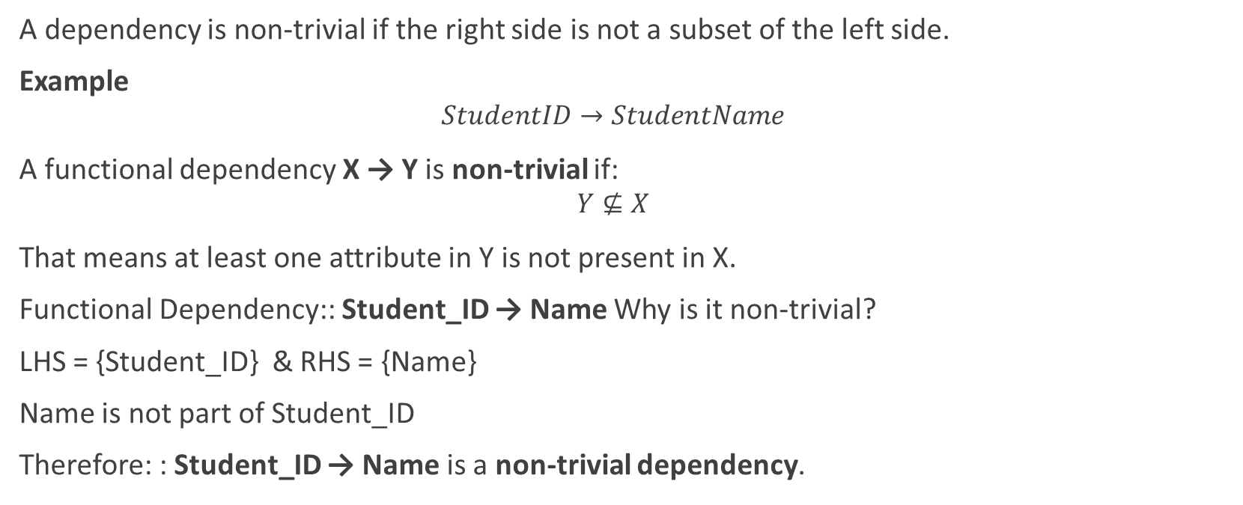
Non-Trivial Functional Dependency
A dependency is non-trivial if the right side is not a subset of the left side.
Example
$$StudentID→StudentName$$
A functional dependency X → Y is non-trivial if:
$$Y⊈X$$
That means at least one attribute in Y is not present in X.
Functional Dependency:: Student_ID → Name Why is it non-trivial?
LHS = {Student_ID} & RHS = {Name}
Name is not part of Student_ID
Therefore: : Student_ID → Name is a non-trivial dependency.
Student_ID | Name | Department
101 | Ram | BCA
102 | Shyam | BBA
Notes:
Example 2
Student_ID → Department
LHS = {Student_ID}
RHS = {Department}
Since Department is not included in the LHS, it is non-trivial.
Example 3
Consider:
Emp_ID Emp_Name Salary
E101 Hari 50000
E102 Sita 60000
Functional Dependencies:
Emp_ID → Emp_Name
Emp_ID → Salary
Both are non-trivial because Emp_Name and Salary are not part of Emp_ID.
Suppose:
"Knowing a student's Roll Number allows you to determine the student's Name."
Roll_No → Name
This is non-trivial because Name is new information obtained from Roll_No.
Compare with:
"Knowing Roll Number and Name allows you to know Name."
(Roll_No, Name) → Name
This is trivial because Name was already known.
Completely Non-Trivial Functional Dependency
A stronger form is completely non-trivial dependency.
A dependency X → Y is completely non-trivial if:
$$X∩Y=∅$$
That means the LHS and RHS share no common attributes.
Example
Student_ID → Name
X = {Student_ID}
Y = {Name}
No common attribute
Hence it is completely non-trivial.

Slide 37
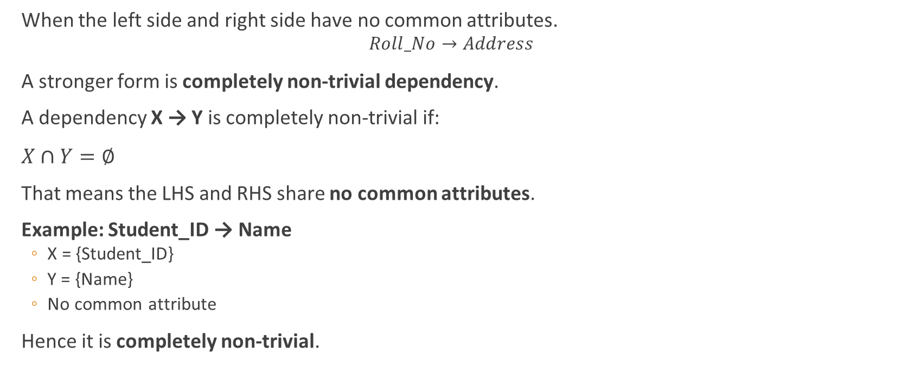
Completely Non-Trivial Dependency
When the left side and right side have no common attributes.
$$Roll_No→Address$$
A stronger form is completely non-trivial dependency.
A dependency X → Y is completely non-trivial if:
$X∩Y=∅$
That means the LHS and RHS share no common attributes.
Example: Student_ID → Name
X = {Student_ID}
Y = {Name}
No common attribute
Hence it is completely non-trivial.
Notes:
Consider:
(A, B) → (B, C)
RHS contains B (already in LHS) and C (not in LHS)
Since the entire RHS is not a subset of the LHS:
$$\left(B , C\right)⊈\left(A , B\right)$$
This dependency is non-trivial, but not completely non-trivial because B appears on both sides.

Slide 38
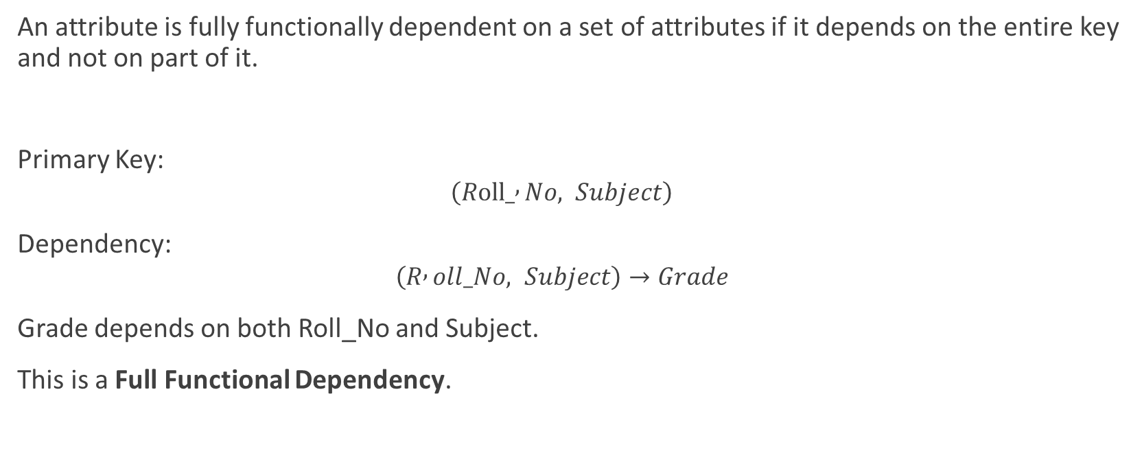
Full Functional Dependency
An attribute is fully functionally dependent on a set of attributes if it depends on the entire key and not on part of it.
Primary Key:
$$\left(Roll_ , No, Subject\right)$$
Dependency:
$$\left(R , oll_No, Subject\right)→Grade$$
Grade depends on both Roll_No and Subject.
This is a Full Functional Dependency.
Roll_No | Subject | Grade
101 | DBMS | A
101 | OS | B

Slide 39
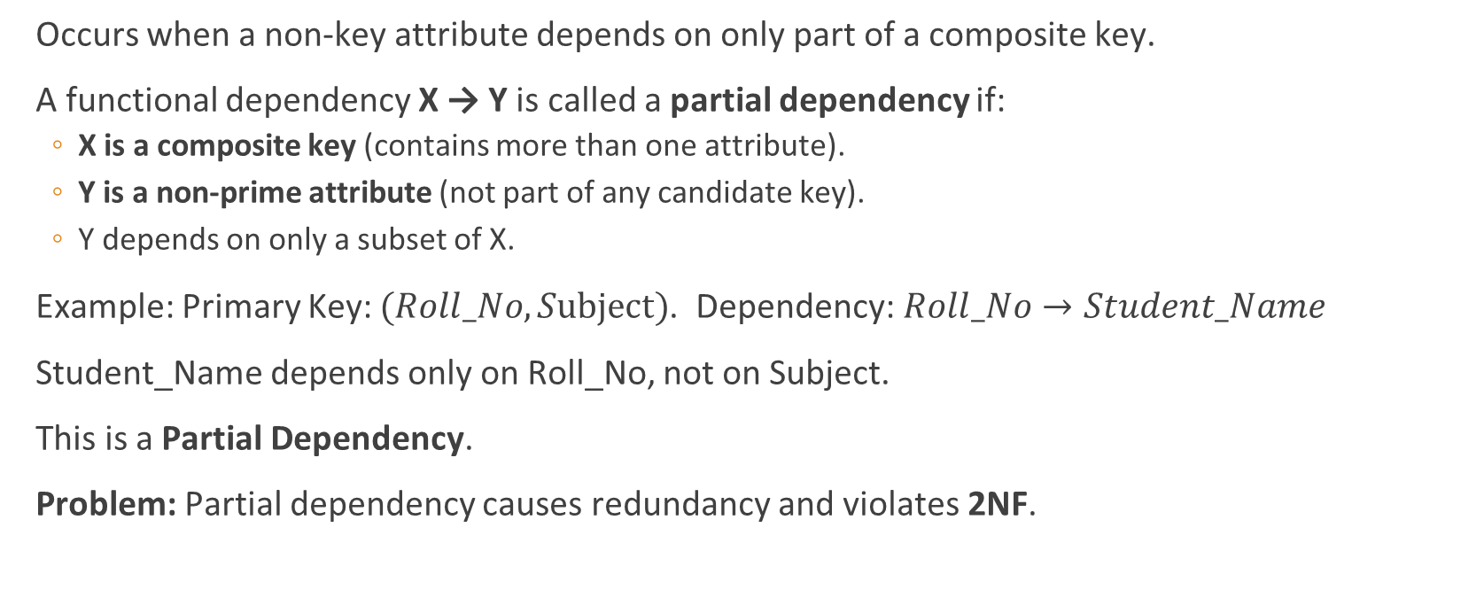
Partial Functional Dependency
Occurs when a non-key attribute depends on only part of a composite key.
A functional dependency X → Y is called a partial dependency if:
X is a composite key (contains more than one attribute).
Y is a non-prime attribute (not part of any candidate key).
Y depends on only a subset of X.
Example: Primary Key: $(Roll_No, Subject)$. Dependency:$Roll_No→Student_Name$
Student_Name depends only on Roll_No, not on Subject.
This is a Partial Dependency.
Problem: Partial dependency causes redundancy and violates 2NF.
Notes:
A partial dependency occurs when a non-key attribute depends on only a part of a composite primary key, rather than on the entire composite key.
Partial dependencies are important because they cause data redundancy and violate Second Normal Form (2NF).
A functional dependency X → Y is called a partial dependency if:
X is a composite key (contains more than one attribute).
Y is a non-prime attribute (not part of any candidate key).
Y depends on only a subset of X.

Slide 40
Example:
Primary Key: The combination: (Student_ID, Subject_ID) uniquely identifies each record.
Functional Dependencies
(Student_ID, Subject_ID) → Marks
Student_ID → Student_Name
Subject_ID → Subject_Name
Lets consider, Student_Id → Stu_Name
Here Primary Key = (Student_ID, Subject_ID)
Student_Name depends only on Student_ID , It does not need Subject_ID
Therefore: Student_ID → Student_Name is a partial dependency.
Similarly: Subject_ID → Subject_Name is also a partial dependency
Student_ID | Subject_ID | Stu_Name | Subject_Name | Marks
S101 | DBMS | Ram | Database Systems | 85
S101 | OS | Ram | Operating Systems | 78
S102 | DBMS | Shyam | Database Systems | 90

Slide 41
Removing Partial Dependency (Convert to 2NF)
Student_ID | Subject_ID | Stu_Name | Subject_Name | Marks
S101 | DBMS | Ram | Database Systems | 85
S101 | OS | Ram | Operating Systems | 78
S102 | DBMS | Shyam | Database Systems | 90
Split the table:
Now:
Student_Name depends only on Student_ID.
Subject_Name depends only on Subject_ID.
Marks depends on the full key (Student_ID, Subject_ID).
Hence, No partial dependencies remain.
Enrollment Table
Student Table
Subject Table
Student_ID | Subject_ID | Marks
S101 | DBMS | 85
S101 | OS | 78
S102 | DBMS | 90
Student_ID | Student_Name
S101 | Ram
S102 | Shyam
Subject_ID | Subject_Name
DBMS | Database Systems
OS | Operating Systems

Slide 42
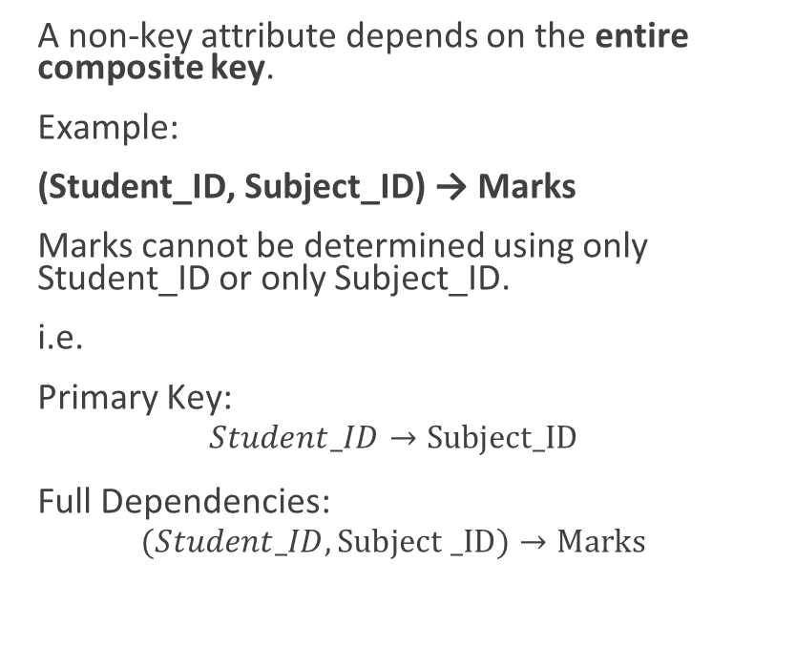
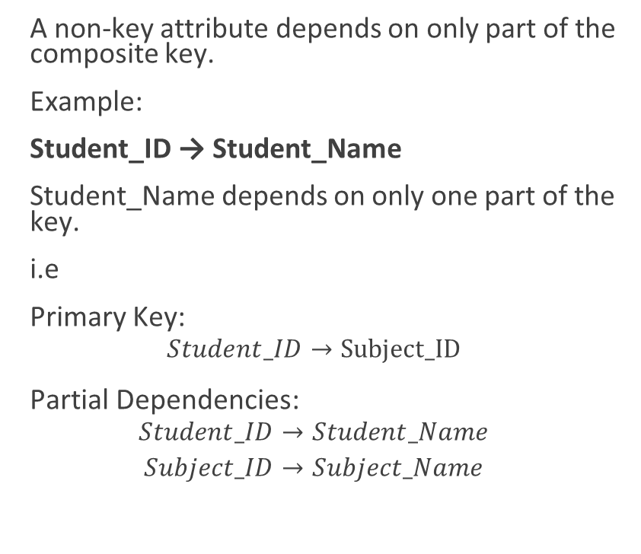
Full vs partial dependencies
A non-key attribute depends on the entire composite key.
Example:
(Student_ID, Subject_ID) → Marks
Marks cannot be determined using only Student_ID or only Subject_ID.
i.e.
Primary Key:
$$Student_ID→Subject_ID$$
Full Dependencies:
$$(Student_ID, Subject _ID)→Marks$$
A non-key attribute depends on only part of the composite key.
Example:
Student_ID → Student_Name
Student_Name depends on only one part of the key.
i.e
Primary Key:
$$Student_ID→Subject_ID$$
Partial Dependencies:
$$Student_ID→Student_Name$$
$$Subject_ID→Subject_Name$$
Notes:
Dependency Type
Student_ID → Student_Name Partial
Subject_ID → Subject_Name Partial
(Student_ID, Subject_ID) → Marks Full FD

Slide 43
Why important?
FDs help in:
Identifying candidate keys.
Eliminating redundancy.
Detecting anomalies.
Performing normalization (1NF, 2NF, 3NF, BCNF).
Improve consistence and data integrity
Notes:
Identify Candidate Keys
A candidate key is an attribute (or set of attributes) that uniquely identifies each row.
Example
Roll_No Name Department
101 Ram BCA
102 Shyam BBA
Given:
$$Roll_No→Name,Department$$
Since Roll_No determines all other attributes, Roll_No is a candidate key.
Without functional dependencies, identifying keys would be difficult.
2. Reduce Data Redundancy
Consider:
Student_IDStudent_NameSubjectTeacherS101RamDBMSHariS101RamOSSitaS101RamCNGita
Here:
$$Student_ID→Student_Name$$
The student's name is repeated multiple times.
Functional dependencies help identify such redundancy and guide decomposition into separate tables.
3. Prevent Update Anomalies
Suppose Ram changes his name.
Without normalization:
Student_IDStudent_NameS101RamS101RamS101Ram
Every row must be updated.
Missing even one update causes inconsistency.
Functional dependencies help identify these situations and eliminate them through normalization.
4. Prevent Insert Anomalies
Consider:
Student_IDStudent_NameSubjectS101RamDBMS
Suppose a new student joins but hasn't selected a subject yet.
Where do you store the student information?
This is an insert anomaly.
Proper decomposition based on functional dependencies solves this problem.
5. Prevent Delete Anomalies
Suppose:
Student_IDStudent_NameSubjectS101RamDBMS
If this row is deleted because Ram drops DBMS, student information is also lost.
This is a delete anomaly.
Functional dependencies help detect such design flaws.
6. Foundation of Normalization
Functional dependencies are the basis for normalization.
Normal FormUses Functional Dependencies?1NFNo (mainly atomic values)2NFYes (remove partial dependencies)3NFYes (remove transitive dependencies)BCNFYes (every determinant must be a candidate key)
Without FDs, normalization cannot be performed correctly.
7. Improve Database Consistency
Example:
$$Employee_ID→Salary$$
If Employee_ID 101 has two different salaries stored in different rows, the FD is violated.
FDs define rules that maintain consistency.
8. Help in Database Decomposition
Suppose:
Student_IDStudent_NameDept_Name
FDs:
$$Student_ID→Student_Name$$
$$Dept_ID→Dept_Name$$
Using these dependencies, we can decompose the table into:
Student
| Student_ID | Student_Name | Dept_ID |
Department
| Dept_ID | Dept_Name |
This reduces redundancy and improves maintainability.
9. Help Query Optimization
Database designers and query optimizers can use functional dependencies to:
Eliminate unnecessary joins
Improve query plans
Reduce storage requirements
Although users may not see it directly, DBMS engines often use dependency information internally.
Real-World Example
Consider a college ERP system (similar to the timetable and ERP systems you've been designing):
Faculty Table
Faculty_IDFaculty_NameEmail
FD:
$$Faculty_ID→Faculty_Name,Email$$
This tells us:
Faculty_ID uniquely identifies a faculty member.
Faculty_Name and Email should not be repeatedly stored in timetable records.
Instead, timetable tables should reference Faculty_ID.
This leads to a cleaner and more scalable design.

Slide 44
Armstrong’s Axioms.
Proposed by William W. Armstrong (1974), formed the theoretical foundation for reasoning about functional dependencies in relational databases.
Armstrong's Axioms are a set of inference rules used to derive all valid functional dependencies from a given set of functional dependencies.
Three Basic Rules
Reflexivity
Augmentation
Transitivity
Why Are Armstrong's Axioms Important?
Find new functional dependencies.
Compute attribute closures.
Identify candidate keys.
Verify normalization (2NF, 3NF, BCNF).
Determine whether a dependency is implied by others.

Slide 45
Armstrong's Axioms
A set of inference rules used to derive new functional dependencies.
Developed by William Armstrong.
Three Basic Rules
Reflexivity
Augmentation
Transitivity

Slide 46
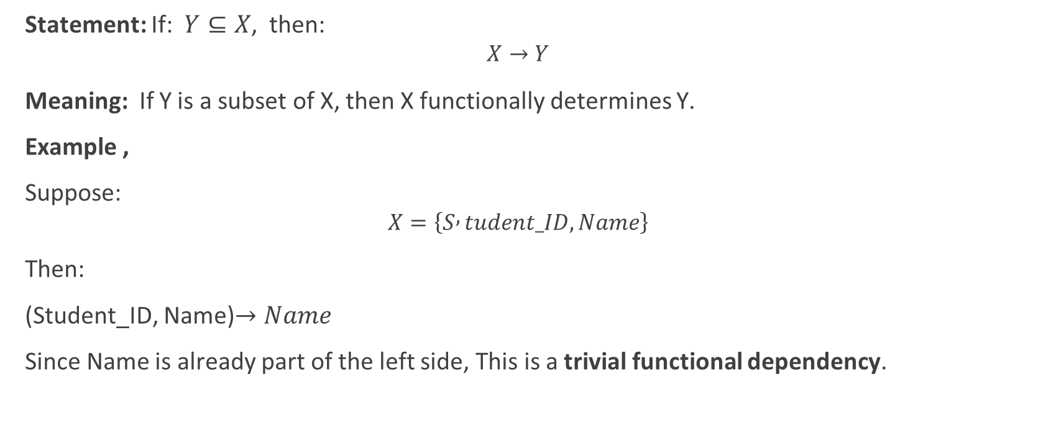
Reflexivity Rule:
Statement: If:$Y⊆X$, then:
$$X→Y$$
Meaning: If Y is a subset of X, then X functionally determines Y.
Example ,
Suppose:
$$X=\left\{S , tudent_ID, Name\right\}$$
Then:
(Student_ID, Name)$→Name$
Since Name is already part of the left side, This is a trivial functional dependency.

Slide 47
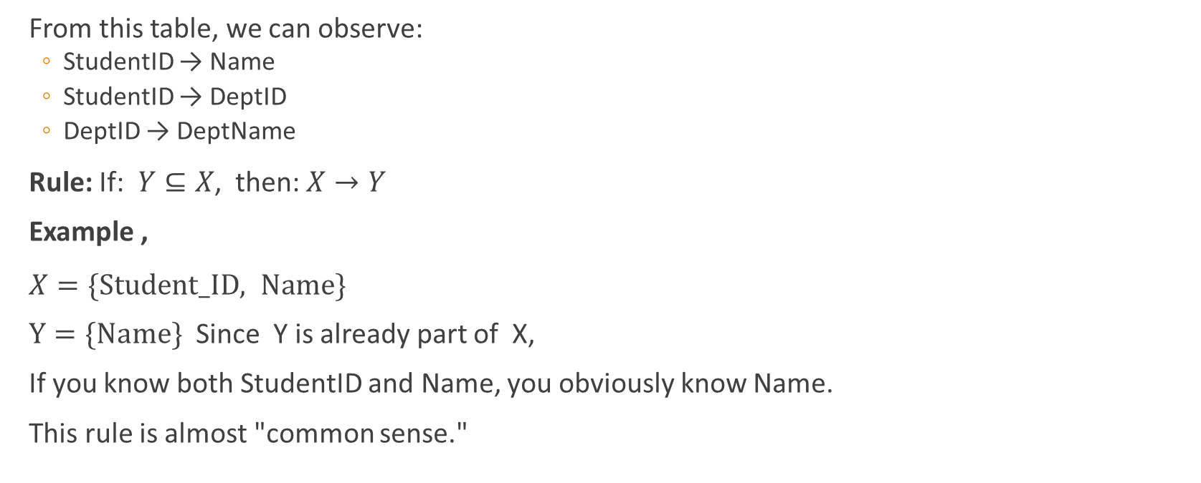
Reflexivity Rule:
From this table, we can observe:
StudentID → Name
StudentID → DeptID
DeptID → DeptName
Rule: If:$Y⊆X$, then:$X→Y$
Example ,
$X=\{Student_ID, Name\}$
$Y=\{Name\}$ Since Y is already part of X,
If you know both StudentID and Name, you obviously know Name.
This rule is almost "common sense."
StudentID | Name | DeptID | DeptName
101 | Ram | D01 | Computer
102 | Sita | D02 | Civil
103 | Hari | D01 | Computer
104 | Gita | D03 | Electrical
StudentID | Name
101 | Ram
102 | Sita
103 | Hari

Slide 48
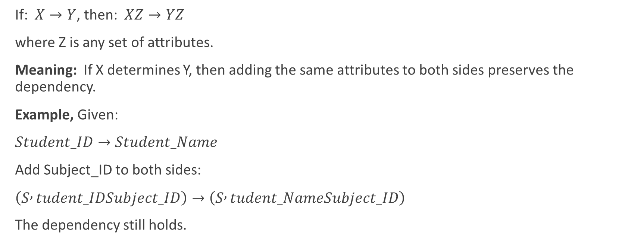
Augmentation Rule
If: $X→Y$, then: $XZ→YZ$
where Z is any set of attributes.
Meaning: If X determines Y, then adding the same attributes to both sides preserves the dependency.
Example, Given:
$Student_ID→Student_Name$
Add Subject_ID to both sides:
$\left(S , tudent_IDSubject_ID\right)→\left(S , tudent_NameSubject_ID\right)$
The dependency still holds.

Slide 49
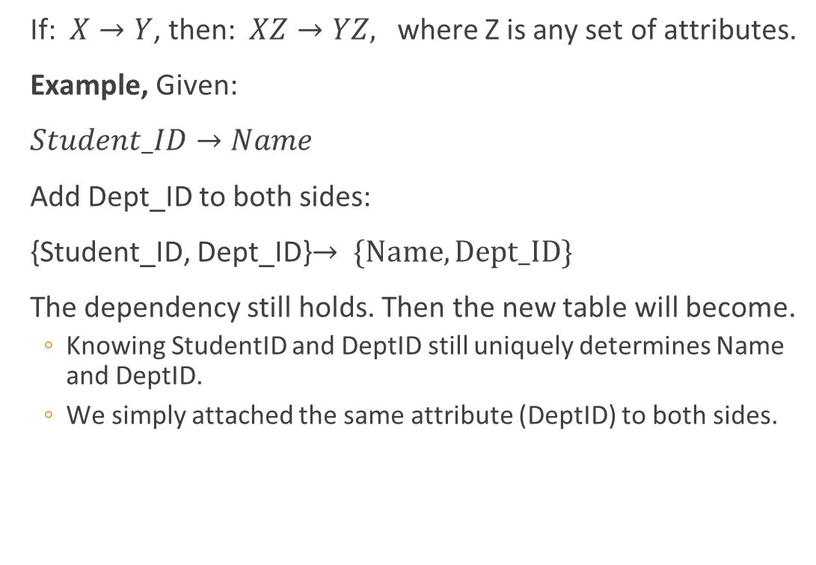
Augmentation Rule
If: $X→Y$, then: $XZ→YZ,$ where Z is any set of attributes.
Example, Given:
$Student_ID→Name$
Add Dept_ID to both sides:
{Student_ID, Dept_ID}$→ \{Name, Dept_ID\}$
The dependency still holds. Then the new table will become.
Knowing StudentID and DeptID still uniquely determines Name and DeptID.
We simply attached the same attribute (DeptID) to both sides.
StudentID | Name
101 | Ram
102 | Sita
StudentID | DeptID | Name
101 | D01 | Ram
102 | D02 | Sita

Slide 50
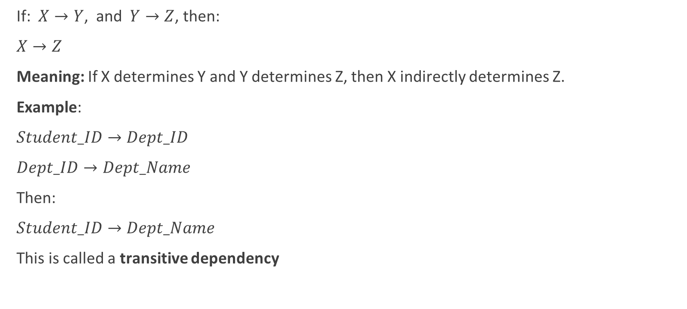
Transitivity Rule
If: $X→Y$, and $Y→Z$, then:
$X→Z$
Meaning: If X determines Y and Y determines Z, then X indirectly determines Z.
Example:
$Student_ID→Dept_ID$
$Dept_ID→Dept_Name$
Then:
$Student_ID→Dept_Name$
This is called a transitive dependency
StudentID | DeptID | DeptName
101 | D01 | Computer
102 | D02 | Civil
103 | D01 | Computer
Notes:
Reasoning
StudentID 101 gives:
StudentID = 101
↓
DeptID = D01
↓
DeptName = Computer
Therefore:
StudentID → DeptName

Slide 51
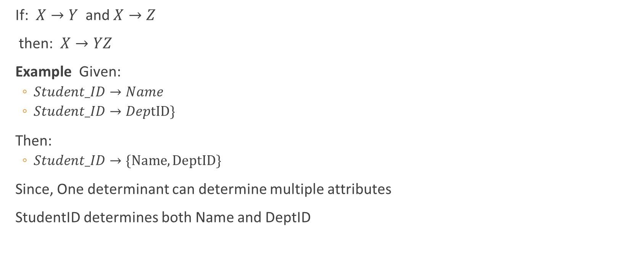
Union Rule
If:$X→Y$ and$X→Z$
then: $X→YZ$
Example Given:
$Student_ID→Name$
$Student_ID→DeptID\}$
Then:
$Student_ID→\{Name, DeptID\}$
Since, One determinant can determine multiple attributes
StudentID determines both Name and DeptID
StudentID | Name | DeptID
101 | Ram | D01
102 | Sita | D02

Slide 52

Decomposition Rule
If: $X→YZ$
then: $X→Y$ and $X→Z$
Example, Given:
$Student_ID→\{Name , DeptID\}$
Then: we can split this into
$Student_ID→Name$
And
$Student_ID→DeptID$
StudentID | Name | DeptID
101 | Ram | D01
102 | Sita | D02
StudentID | Name
101 | Ram
102 | Sita
StudentID | DeptID
101 | D01
102 | D02
Notes:
XY → z != X→Z , Y→Z
We can decompose lefet hand side

Slide 53

Pseudo-transitivity Rule
If:$X→Y$ and $WY→Z$, then:$WX→Z$
Example, Given:
$Student_ID→Dept_ID$
i.e. StudentID gives DeptID.
AND
$\left(DeptID, , CourseID\right)→Faculty$
i.e. DeptID + CourseID gives Faculty.
Then:
$\left(S , tudent_ID, Course_ID\right)→Faculty$
StudentID | DeptID | CourseID | Faculty
101 | D01 | C101 | Dr. Sharma
102 | D02 | C102 | Dr. Karki

Slide 54

Applying Armstrong’s axioms
Given FDs:
$$Student_ID→Dept_ID$$
$$Dept_ID→Dept_Name$$
Find:$Student_ID→Dept_Name$
Using Transitivity:
$$Student_ID→Dept_ID$$
$$Dept_ID→Dept_Name$$
Therefore:$Student_ID→Dept_Name$

Slide 55
Summary of Axioms
Axiom | Rule | Example
Reflexivity | If Y ⊆ X, then X → Y | (A,B) → A
Augmentation | If X → Y, then XZ → YZ | A → B ⇒ AC → BC
Transitivity | If X → Y and Y → Z, then X → Z | A → B, B → C ⇒ A → C
Union | If X → Y and X → Z, then X → YZ | A → B, A → C ⇒ A → BC
Decomposition | If X → YZ, then X → Y and X → Z | A → BC ⇒ A → B, A → C
Pseudotransitivity | If X → Y and WY → Z, then WX → Z | A → B, CB → D ⇒ AC → D

Slide 56
Closure of a Set of Functional Dependencies
Closure of a set of functional dependencies (F⁺) is the complete set of all FDs that can be derived from a given set of functional dependencies F using:
Reflexivity,
Augmentation, and
Transitivity.
F⁺ = All original FDs + all dependencies that can be logically inferred from them.
Closure helps us:
Find candidate keys.
Check whether a dependency is implied by others.
Verify normalization (2NF, 3NF, BCNF).
Remove redundant dependencies.

Slide 57

Example
Consider relation: R(A, B, C)
Given: $F=\left\{A , →B\text{,} B→C\right\}$
Original Dependencies
A → B , B → C
Using Transitivity, Since:$A→B$ and$B→C$
Therefore: $A→C$
F⁺ Contains
A → B C A
B → C BA
A → C
plus, trivial dependencies such as:
AB → A
AB → B
ABC → A
ABC → B
etc.
These all together form F⁺.

Slide 58

Example:
Given Relation is : R(A,B,C,G,H,I), find the closure set of functional dependencies (F⁺).
Functional Dependencies (F):
$A→B$
$CG→I$
$A→C$
$B→H$
$CG→H$
.FD+ = ?
Closure set of attributes (X+) = ?
find functional dependencies, for R= (ABCDEF), A->BC, B->E, C->EF, E->CF
Notes:
Note:
Finding attribute closure $X^{+}$→ Usually no need for explicit augmentation.
Finding useful FDs in $F^{+}$→ Mostly use reflexivity, transitivity, union, decomposition.
Proving a specific FD → Augmentation may become necessary.

Slide 59
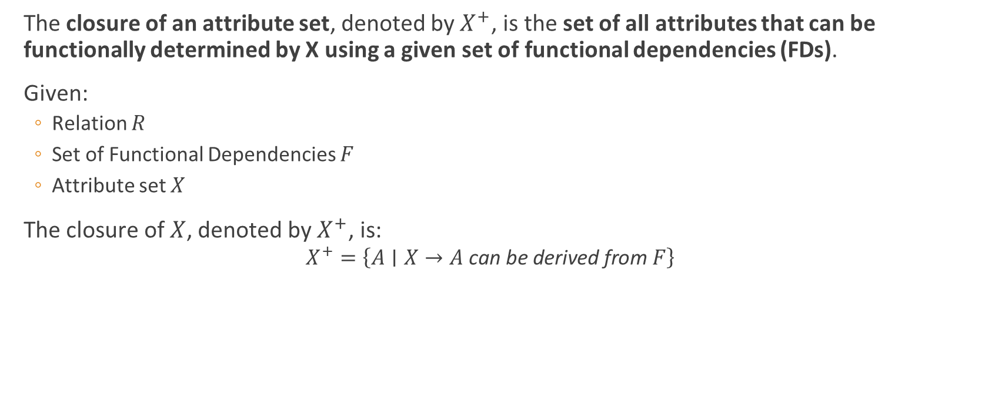
Closure of Attribute Sets
The closure of an attribute set, denoted by $X^{+}$, is the set of all attributes that can be functionally determined by X using a given set of functional dependencies (FDs).
Given:
Relation $R$
Set of Functional Dependencies $F$
Attribute set $X$
The closure of $X$, denoted by $X^{+}$, is:
$$X^{+}=\left\{A∣X→A \text{can} \text{be} \text{derived} \text{from} F\right\}$$
Notes:
Attribute closure tells us all the attributes that can be obtained or inferred starting
Why Do We Need Attribute Closure?
Attribute closure is used to:
Find Candidate Keys
Check whether an FD is implied by a set of FDs
Find Super Keys
Perform Normalization
Determine whether a decomposition is lossless
from a given attribute set.

Slide 60
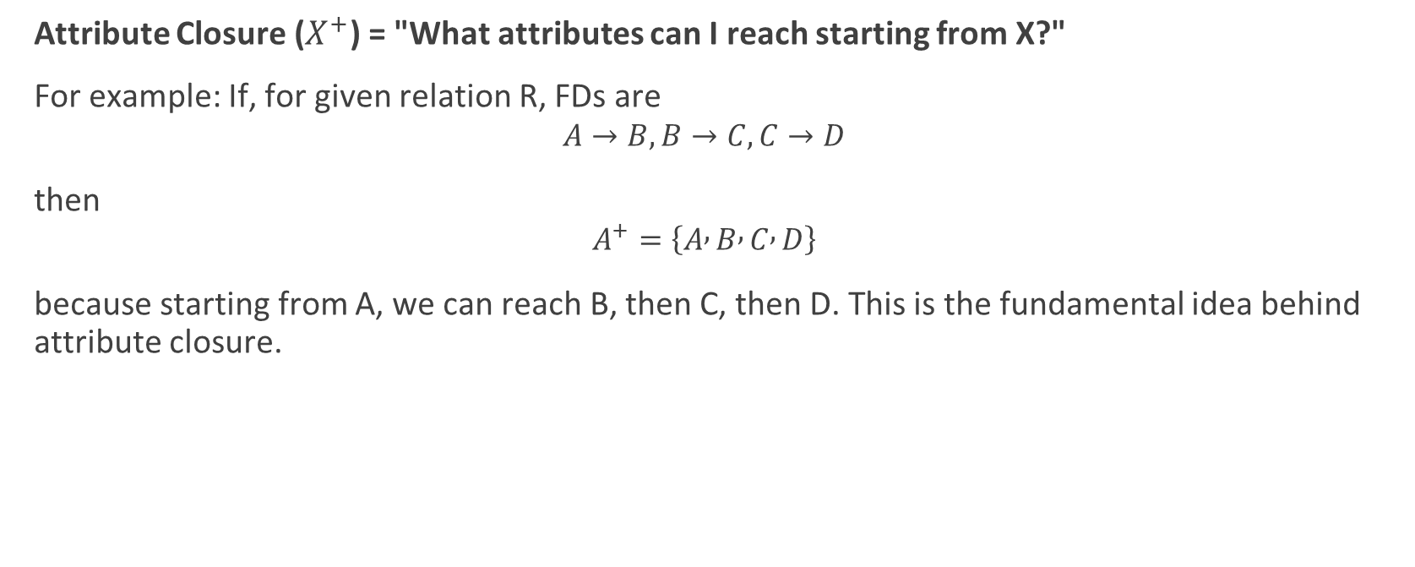
Concept
Attribute Closure ($X^{+}$) = "What attributes can I reach starting from X?"
For example: If, for given relation R, FDs are
$$A→B, B→C, C→D$$
then
$$A^{+}=\left\{A , B , C , D\right\}$$
because starting from A, we can reach B, then C, then D. This is the fundamental idea behind attribute closure.

Slide 61
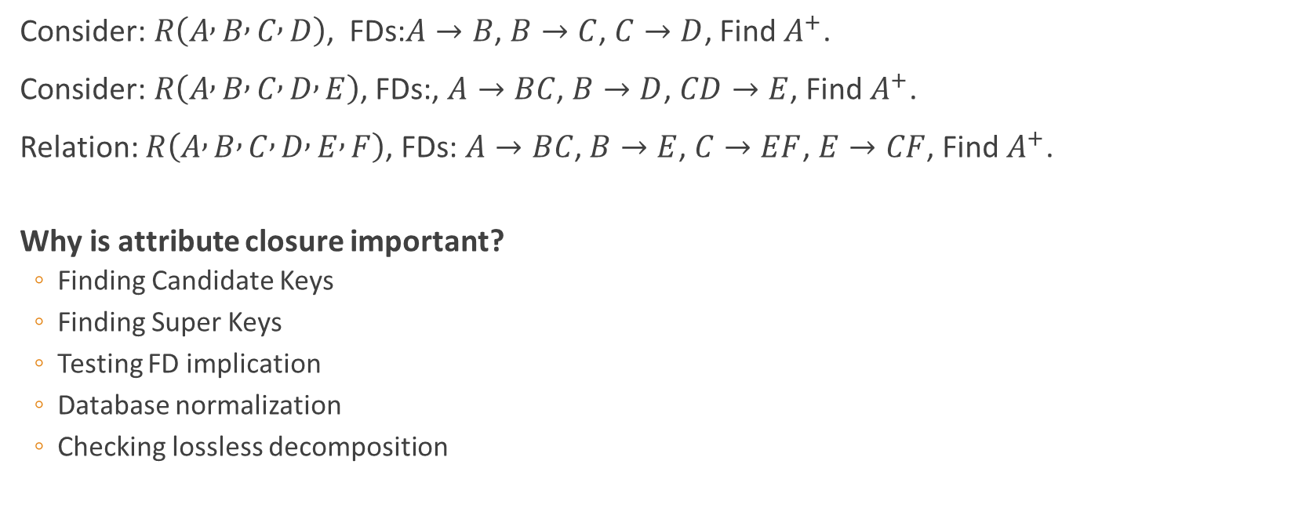
Examples
Consider:$R\left(A , B , C , D\right)$, FDs:$A→B$, $B→C$, $C→D$, Find $A^{+}$.
Consider:$R\left(A , B , C , D , E\right)$, FDs:, $A→BC$, $B→D$, $CD→E$, Find $A^{+}$.
Relation: $R\left(A , B , C , D , E , F\right)$, FDs: $A→BC$, $B→E$, $C→EF$, $E→CF$, Find $A^{+}$.
Why is attribute closure important?
Finding Candidate Keys
Finding Super Keys
Testing FD implication
Database normalization
Checking lossless decomposition

Slide 62
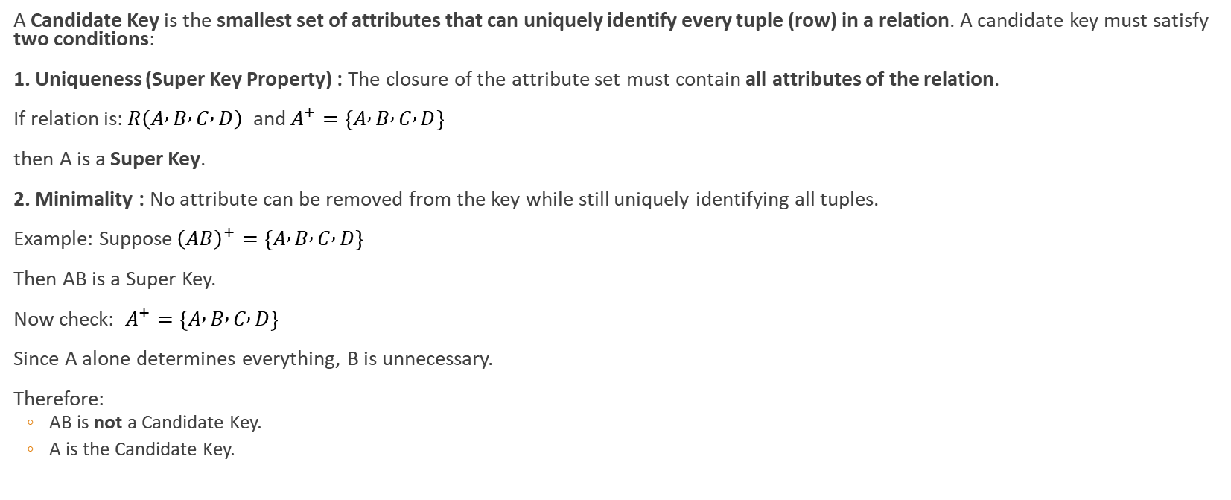
Find Candidate key
A Candidate Key is the smallest set of attributes that can uniquely identify every tuple (row) in a relation. A candidate key must satisfy two conditions:
1. Uniqueness (Super Key Property) : The closure of the attribute set must contain all attributes of the relation.
If relation is:$R\left(A , B , C , D\right)$ and$A^{+}=\left\{A , B , C , D\right\}$
then A is a Super Key.
2. Minimality : No attribute can be removed from the key while still uniquely identifying all tuples.
Example: Suppose${\left(AB\right)}^{+}=\left\{A , B , C , D\right\}$
Then AB is a Super Key.
Now check: $A^{+}=\left\{A , B , C , D\right\}$
Since A alone determines everything, B is unnecessary.
Therefore:
AB is not a Candidate Key.
A is the Candidate Key.
Notes:
Rules for Finding Candidate Keys
Rule 1: Attributes Never Appearing on RHS Must Be in Every Candidate Key
Example:
$$R\left(A , B , C , D\right)$$
FDs:
$$A→B$$
$$B→C$$
Notice D never appears on RHS.
Therefore D cannot be derived from any FD.
So every Candidate Key must contain D.
Rule 2: Find Attribute Closure
Compute closure of attribute combinations.
If closure contains all attributes of R, then it is a Super Key.
Rule 3: Check Minimality
Remove one attribute at a time.
If closure still gives all attributes, the original set is not minimal.
Example 1
Relation:
$$R\left(A , B , C , D\right)$$
FDs:
$$A→B$$
$$B→C$$
$$C→D$$
Find A⁺
$$A^{+}=\left\{A , B , C , D\right\}$$
Contains all attributes.
So A is a Super Key.
Since A has only one attribute, nothing can be removed.
Therefore:
Candidate Key = {A}
Example 2
Relation:
$$R\left(A , B , C , D\right)$$
FDs:
$$A→B$$
$$C→D$$
Find AC⁺
Start:
$$AC^{+}=\left\{A , C\right\}$$
Apply:
$$A→B$$
$$AC^{+}=\left\{A , B , C\right\}$$
Apply:
$$C→D$$
$$AC^{+}=\left\{A , B , C , D\right\}$$
Contains all attributes.
So AC is a Super Key.
Check subsets:
$$A^{+}=\left\{A , B\right\}$$
Not all attributes.
$$C^{+}=\left\{C , D\right\}$$
Not all attributes.
Therefore neither A nor C alone is sufficient.
Hence:
Candidate Key = {AC}
Example 3
Relation:
$$R\left(A , B , C , D , E , F\right)$$
FDs:
$$A→BC$$
$$B→E$$
$$C→EF$$
$$E→CF$$
Step 1: Find attributes not on RHS
RHS contains:
$$\left\{B , C , E , F\right\}$$
Attributes not on RHS:
$$\left\{A , D\right\}$$
Therefore every Candidate Key must contain A and D.
Step 2: Find (AD)⁺
Start:
$${\left(AD\right)}^{+}=\left\{A , D\right\}$$
Using
$$A→BC$$
$$\left\{A , B , C , D\right\}$$
Using
$$B→E$$
$$\left\{A , B , C , D , E\right\}$$
Using
$$C→F$$
$$\left\{A , B , C , D , E , F\right\}$$
All attributes obtained.
Therefore:
$${\left(AD\right)}^{+}=R$$
So AD is a Super Key.
Step 3: Check Minimality
$$A^{+}=\left\{A , B , C , E , F\right\}$$
Missing D.
$$D^{+}=\left\{D\right\}$$
Missing others.
Neither A nor D alone works.
Therefore:
Candidate Key = {AD}

Slide 63
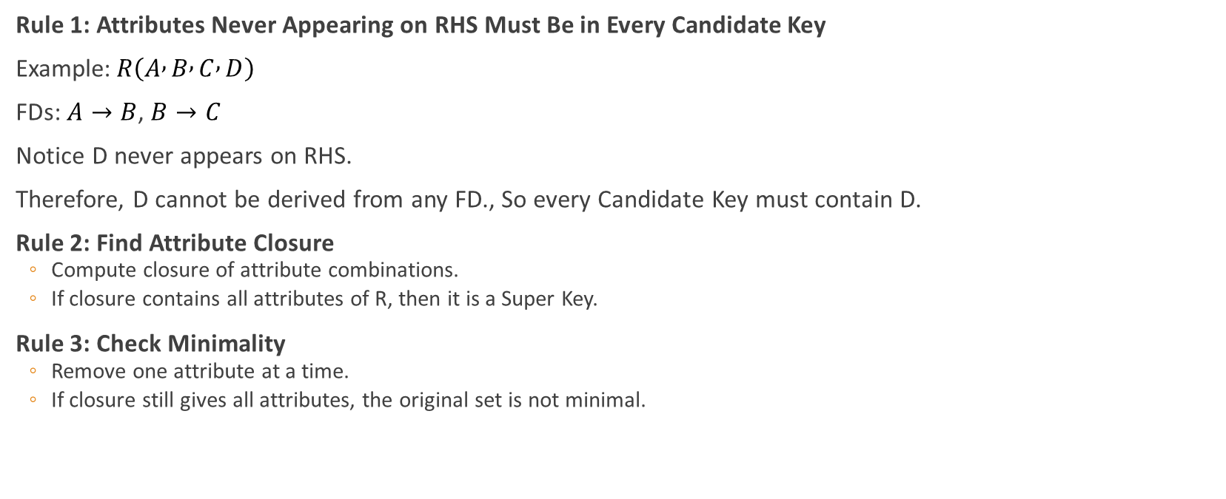
Rules:
Rule 1: Attributes Never Appearing on RHS Must Be in Every Candidate Key
Example:$R\left(A , B , C , D\right)$
FDs:$A→B$, $B→C$
Notice D never appears on RHS.
Therefore, D cannot be derived from any FD., So every Candidate Key must contain D.
Rule 2: Find Attribute Closure
Compute closure of attribute combinations.
If closure contains all attributes of R, then it is a Super Key.
Rule 3: Check Minimality
Remove one attribute at a time.
If closure still gives all attributes, the original set is not minimal.

Slide 64
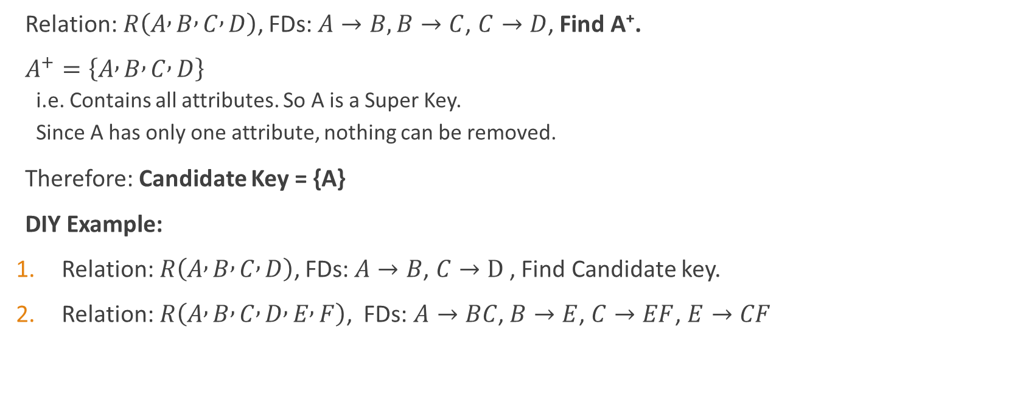
Example:
Relation:$R\left(A , B , C , D\right)$, FDs:$A→B, B→C$, $C→D$, Find A⁺.
$A^{+}=\left\{A , B , C , D\right\}$
i.e. Contains all attributes. So A is a Super Key.
Since A has only one attribute, nothing can be removed.
Therefore: Candidate Key = {A}
DIY Example:
Relation:$R\left(A , B , C , D\right)$, FDs:$A→B$, $C→D$, Find Candidate key.
Relation:$R\left(A , B , C , D , E , F\right)$, FDs: $A→BC$, $B→E$, $C→EF$, $E→CF$
Notes:
Example 2
Relation:
$$R\left(A , B , C , D\right)$$
FDs:
$$A→B$$
$$C→D$$
Find AC⁺
Start:
$$AC^{+}=\left\{A , C\right\}$$
Apply:
$$A→B$$
$$AC^{+}=\left\{A , B , C\right\}$$
Apply:
$$C→D$$
$$AC^{+}=\left\{A , B , C , D\right\}$$
Contains all attributes.
So AC is a Super Key.
Check subsets:
$$A^{+}=\left\{A , B\right\}$$
Not all attributes.
$$C^{+}=\left\{C , D\right\}$$
Not all attributes.
Therefore neither A nor C alone is sufficient.
Hence:
Candidate Key = {AC}
.
Example 3
Relation:
$$R\left(A , B , C , D , E , F\right)$$
FDs:
$$A→BC$$
$$B→E$$
$$C→EF$$
$$E→CF$$
Step 1: Find attributes not on RHS
RHS contains:
$$\left\{B , C , E , F\right\}$$
Attributes not on RHS:
$$\left\{A , D\right\}$$
Therefore every Candidate Key must contain A and D.
Step 2: Find (AD)⁺
Start:
$${\left(AD\right)}^{+}=\left\{A , D\right\}$$
Using
$$A→BC$$
$$\left\{A , B , C , D\right\}$$
Using
$$B→E$$
$$\left\{A , B , C , D , E\right\}$$
Using
$$C→F$$
$$\left\{A , B , C , D , E , F\right\}$$
All attributes obtained.
Therefore:
$${\left(AD\right)}^{+}=R$$
So AD is a Super Key.
Step 3: Check Minimality
$$A^{+}=\left\{A , B , C , E , F\right\}$$
Missing D.
$$D^{+}=\left\{D\right\}$$
Missing others.
Neither A nor D alone works.
Therefore:
Candidate Key = {AD}
Shortcut Method
Step 1
Write all attributes that never appear on RHS.
These must be part of every candidate key.
Step 2
Compute closure of that set.
Step 3
If closure is not all attributes, add attributes one by one and recompute.
Step 4
When closure contains all attributes, check minimality.

Slide 65
Normalization
Normalization is the process of organizing data in a relational database to:
Reduce data redundancy (duplicate data)
Eliminate undesirable characteristics such as insertion, update, and deletion anomalies
Improve data consistency and integrity
Make database maintenance easier
Normalization divides larger tables into smaller, related tables and establishes relationships between them using keys.
Before Normalization: The table is prone to redundancy and anomalies (insertion, update, and deletion).
After Normalization: The data is divided into logical tables to ensure consistency, avoid redundancy and remove anomalies making the database efficient and reliable.
Notes:
Features of Database Normalization
Elimination of Data Redundancy: One of the main features of normalization is to eliminate the data redundancy that can occur in a database. Data redundancy refers to the repetition of data in different parts of the database. Normalization helps in reducing or eliminating this redundancy, which can improve the efficiency and consistency of the database.
Ensuring Data Consistency: Normalization helps in ensuring that the data in the database is consistent and accurate. By eliminating redundancy, normalization helps in preventing inconsistencies and contradictions that can arise due to different versions of the same data.
Simplification of Data Management: Normalization simplifies the process of managing data in a database. By breaking down a complex data structure into simpler tables, normalization makes it easier to manage the data, update it, and retrieve it.
Improved Database Design: Normalization helps in improving the overall design of the database. By organizing the data in a structured and systematic way, normalization makes it easier to design and maintain the database. It also makes the database more flexible and adaptable to changing business needs.
Standardization: Normalization helps in standardizing the data in the database. By organizing the data into tables and defining relationships between them, normalization helps in ensuring that the data is stored in a consistent and uniform manner.

Slide 66
What normalization solve?
Before normalization, databases suffer from three major anomalies:
Update Anomaly
Changing a student's name requires updating multiple records.
i.e. If instructor Sharma changes to Joshi, every DBMS record must be updated.
Insert Anomaly
Cannot store a student unless they are enrolled in a subject.
Delete Anomaly
Deleting the last student enrolled in AI removes all information about AI.
Normalization removes these anomalies.
Student_Course Table
Stu_ID | Stu_Name | Course_ID | Course_Name | Instructor
S101 | Ram | C001 | DBMS | Sharma
S101 | Ram | C002 | OS | Verma
S102 | Hari | C001 | DBMS | Sharma
S103 | Sita | C003 | AI | Pant

Slide 67
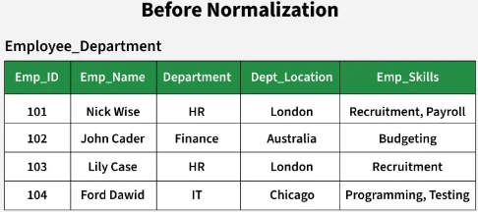
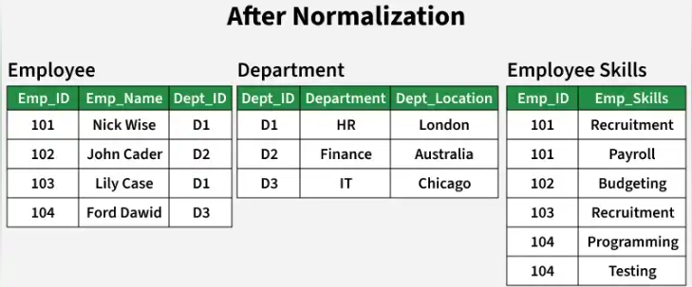
Example:
Notes:
Before Normalization: The table is prone to redundancy and anomalies (insertion, update, and deletion).
After Normalization: The data is divided into logical tables to ensure consistency, avoid redundancy and remove anomalies making the database efficient and reliable.
Problems in the Employee_Department Relation
If a new department is created but no employee is assigned to it yet, we cannot store its location because we need an employee record to insert. It shows insertion anomaly.
If the location of the HR department changes, we must update it in multiple rows (for both Nick Wise and Lily Case). If one row is missed, the data becomes inconsistent.
If all employees in the IT department leave, we lose the department information, including its location.
The department location is repeated for every employee in the same department. It is data redundant.

Slide 68
Types of Normal Forms
Normal Form | Removes | Key Idea
UNF | Repeating groups | Multiple values in attributes
1NF | Non-atomic values | One value per cell
2NF | Partial dependency | Full dependency on entire key
3NF | Transitive dependency | Non-key should not determine non-key
BCNF | Determinant problem | Every determinant must be a candidate key
4NF | Multivalued dependency | Independent multi-valued facts separated
5NF | Join dependency | Eliminate redundancy caused by joins
1 NF
1NF
1 NF
2NF
1 NF
3NF
1 NF
BCNF
1 NF
4NF
5NF
Notes:
Normal Form Question to Ask
1NF Are all values atomic?
2NF Is there any partial dependency?
3NF Is there any transitive dependency?
BCNF Is every determinant a candidate key?
4NF Is there any multivalued dependency?
5NF Is there any join dependency causing redundancy?

Slide 69
Normalization Using a Single Example
Suppose a college stores student enrollment information as follows.
Problems:
Multiple values in one column.
Repeating groups.
Difficult to query.
UNF (Unnormalized Form)
Student_ID | Student_Name | Dept_ID | Dept_Name | Subjects | Teachers | Languages
S101 | Ram | D1 | Computer | DBMS, Java | Kapil, Sunil | English, Nepali
S102 | Hari | D2 | Civil | DBMS, SE | Kapil, Harendra | English

Slide 70
First Normal Form
Now:
✓ No multiple values in one cell
✓ Atomic attributes
Rule: Every cell must contain atomic (indivisible) values.
Convert Multi-valued Attributes into Separate Rows:
Problems:
Since no single attribute uniquely
identifies a row.
Many attributes depend on only
part of the composite
key.
Candidate Key
(Stu_ID, Subject, Language)
Since no single attribute uniquely
identifies a row.
Stu_ID | Stu_Name | Dept_ID | Dept_Name | Subject | Teacher | Language
S101 | Ram | D1 | Computer | DBMS | Sharma | English
S101 | Ram | D1 | Computer | DBMS | Sharma | Nepali
S101 | Ram | D1 | Computer | OS | Verma | English
S101 | Ram | D1 | Computer | OS | Verma | Nepali
S102 | Hari | D2 | Civil | DBMS | Sharma | English
S102 | Hari | D2 | Civil | CN | Pant | English
Notes:
Remaining Problems
Notice:
Student_ID → Student_Name, Dept_ID Dept_ID → Dept_Name Subject → Teacher
Many attributes depend on only part of the composite key.
Thus not in 2NF.

Slide 71
Second Normal Form (2NF)
Rule :
Must be in 1NF
Remove Partial Dependencies
Identify Partial Dependencies :
Current key = (Student_ID, Subject, Language)
Dependencies:
Student_ID → Student_Name, Dept_ID
Dept_ID → Dept_Name
Subject → Teacher
Student_Name depends only on Student_ID.
Teacher depends only on Subject. These are partial dependencies.
Stu_ID | Stu_Name | Dept_ID | Dept_Name | Subject | Teacher | Language
S101 | Ram | D1 | Computer | DBMS | Sharma | English
S101 | Ram | D1 | Computer | DBMS | Sharma | Nepali
S101 | Ram | D1 | Computer | OS | Verma | English
S101 | Ram | D1 | Computer | OS | Verma | Nepali
S102 | Hari | D2 | Civil | DBMS | Sharma | English
S102 | Hari | D2 | Civil | CN | Pant | English
Notes:
Student_Name depends only on Student_ID.
Teacher depends only on Subject.
These are partial dependencies.

Slide 72
Decompose it into
Identify Partial Dependencies :
Current key = (Student_ID, Subject, Language)
Dependencies:
Student_ID → Student_Name, Dept_ID, Dept_name
Dept_ID → Dept_Name
Subject → Teacher
Enrollment
Stu_ID | Subject | Language
S101 | DBMS | English
S101 | DBMS | Nepali
S101 | OS | English
S101 | OS | Nepali
S102 | DBMS | English
S102 | CN | English
SUBJECT
STUDENT
Stu_ID | Stu_Name | Dept_ID | Dept_name
S101 | Ram | D1 | Computer
S102 | Hari | D2 | Civil
Subject | Teacher
DBMS | Sharma
OS | Verma
CN | Pant
Notes:
Remaining Problem
In STUDENT:
Student_ID Student_Name Dept_ID
S101 Ram D1
S102 Hari D2
We still have:
Dept_ID → Dept_Name
Transitive dependency exists.
Not in 3NF.

Slide 73
Third Normal Form (3NF)
Subject | Teacher
DBMS | Sharma
OS | Verma
CN | Pant
Rule
Must be in 2NF
Remove Transitive Dependencies
Dependency
Student_ID → Dept_ID Dept_ID → Dept_Name
Thus: Student_ID → Dept_Name
Indirect dependency.
Stu_ID | Stu_Name | Dept_ID | Dept_name
S101 | Ram | D1 | Computer
S102 | Hari | D2 | Civil
Stu_ID | Subject | Language
S101 | DBMS | English
S101 | DBMS | Nepali
S101 | OS | English
S101 | OS | Nepali
S102 | DBMS | English
S102 | CN | English
Notes:
Why is This a Problem?
1. Update Anomaly
Suppose:
Computer department changes name to:
"Computer Engineering"
Current table:
Student_IDStudent_NameDept_IDDept_NameS101RamD1ComputerS103SitaD1Computer
We must update every student row.
If one row is missed:
Student_IDStudent_NameDept_IDDept_NameS101RamD1Computer EngineeringS103SitaD1Computer
Database becomes inconsistent.
2. Insertion Anomaly
Suppose a new department is created:
Dept_IDDept_NameD3Electronics
But no student has joined yet.
In STUDENT table, we cannot store this information because there is no Student_ID.
3. Deletion Anomaly
Suppose Sita is the only student in Computer department.
If Sita's record is deleted:
Student_ID Student_Name Dept_ID Dept_Name
S103 Sita D1 Computer
The information: D1 = Computeris also lost.

Slide 74
Third Normal Form (3NF)
Enrollment table
Stu_ID | Subject | Language
S101 | DBMS | English
S101 | DBMS | Nepali
S101 | OS | English
S101 | OS | Nepali
S102 | DBMS | English
S102 | CN | English
Student table
Subject_teacher table
Stu_ID | Stu_Name | Dept_ID | Dept_name
S101 | Ram | D1 | Computer
S102 | Hari | D2 | Civil
Subject | Teacher
DBMS | Sharma
OS | Verma
CN | Pant
OLD Tables
No change in this Table
Student table
Department table
Subject_teacher table
Stu_ID | Stu_Name | Dept_ID
S101 | Ram | D1
S102 | Hari | D2
Dept_ID | Dept_Name
D1 | Computer
D2 | Civil
Subject | Teacher
DBMS | Sharma
OS | Verma
CN | Pant
NEW Tables

Slide 75
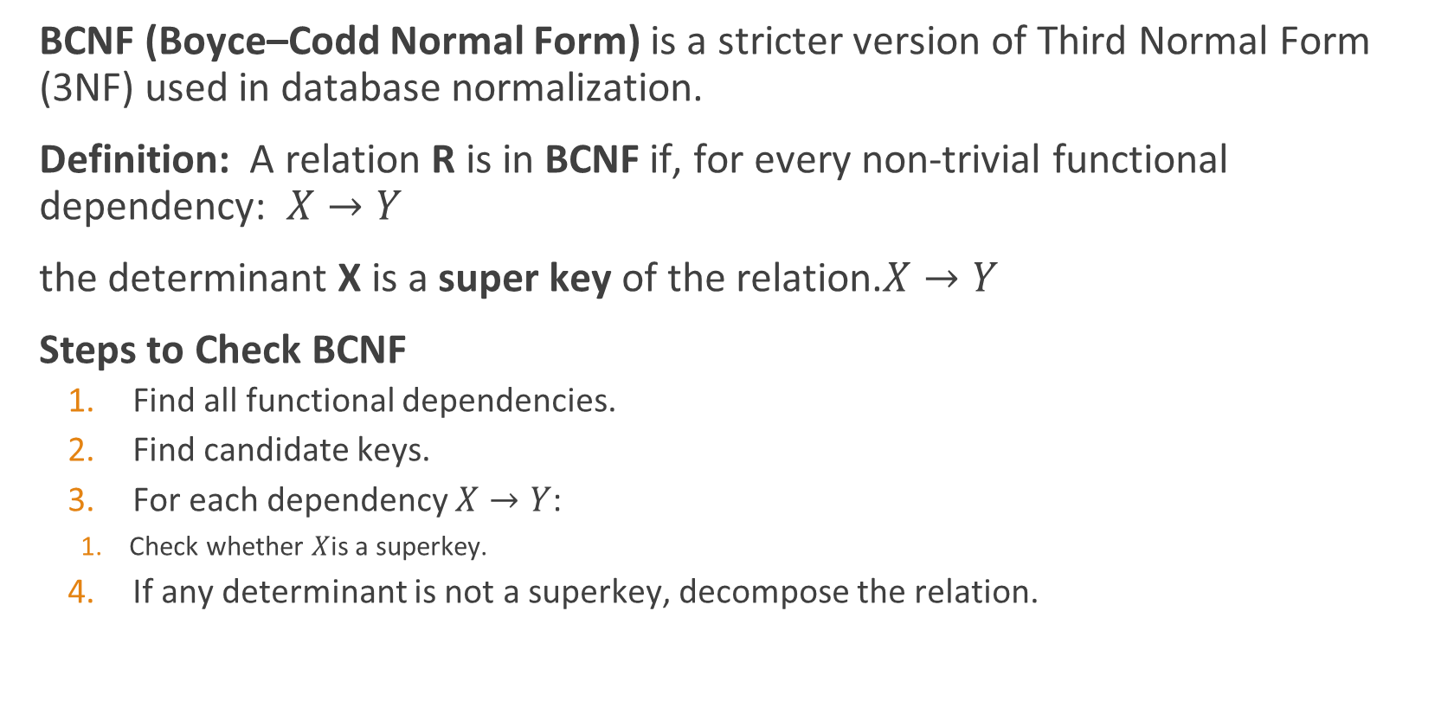
Boyce Codd Normal Form (BCNF)
BCNF (Boyce–Codd Normal Form) is a stricter version of Third Normal Form (3NF) used in database normalization.
Definition: A relation R is in BCNF if, for every non-trivial functional dependency: $X→Y$
the determinant X is a super key of the relation.$X→Y$
Steps to Check BCNF
Find all functional dependencies.
Find candidate keys.
For each dependency $X→Y$:
Check whether $X$is a superkey.
If any determinant is not a superkey, decompose the relation.
Notes:
Key Idea
Every attribute that determines another attribute must itself uniquely identify a tuple (i.e., be a candidate key or super key).

Slide 76
Example:
StudentID | Course | Instructor
S1 | DBMS | Ram
S2 | DBMS | Ram
S3 | AI | Hari
S4 | AI | Hari
S5 | DBMS | Ram
Suppose we have a relation: Teaching(StudentID, Course, Instructor)
Functional Dependencies:
(StudentID, Course) → Instructor
Instructor → Course
Step 1: Find Candidate Key
Step 2: Check Each FD
Notes:
Step 1: Find Candidate Key
Let's find closure of (StudentID, Course).
$${\left(S , tudentIDCourse\right)}^{+}=\left\{S , t , udentIDCourseInstructor\right\}$$
Therefore,
Candidate Key = (StudentID, Course)
Step 2: Check Each FD
FD 1
$$\left(S , tudentIDCourse\right)→Instructor$$
Left side is a candidate key.
✅ Satisfies BCNF
FD 2
$$Instructor→Course$$
Let's check whether Instructor is a superkey.
Closure:
$$Instructor^{+}=\left\{I , nstructorCourse\right\}$$
It does NOT contain StudentID.
Therefore Instructor is not a superkey.
❌ Violates BCNF
What is the Mistake?
Look at the table:
InstructorCourseRamDBMSRamDBMSRamDBMSHariAIHariAI
Notice that Course information is repeated many times.
Redundancy Problem
If Ram teaches DBMS, we are storing that fact repeatedly for every student.
Update Anomaly
Suppose Ram starts teaching "Advanced DBMS".
We must update every row containing Ram.
StudentIDCourseInstructorS1Advanced DBMSRamS2DBMSRamS5DBMSRam
Now the database becomes inconsistent.
Insertion Anomaly
Suppose a new instructor "Shyam" will teach Networks but no student has enrolled yet.
Can we insert:
StudentIDCourseInstructor?NetworksShyam
No, because StudentID is required.
❌ Cannot store instructor-course information independently.
Deletion Anomaly
Suppose S4 is the only student enrolled in AI.
StudentIDCourseInstructorS4AIHari
If we delete S4:
DELETE FROM Teaching WHERE StudentID='S4';
Information that Hari teaches AI is lost.
❌ Deletion anomaly
BCNF Decomposition (Solution)
Split the table into:
InstructorCourse
InstructorCourseRamDBMSHariAI
StudentInstructor
StudentIDInstructorS1RamS2RamS3HariS4HariS5Ram
Check BCNF Again
InstructorCourse
FD:
$$Instructor→Course$$
Instructor is the key.
✅ BCNF
StudentInstructor
No non-key determinant exists.
Key:
$$\left(S , tudentIDInstructor\right)$$
✅ BCNF

Slide 77
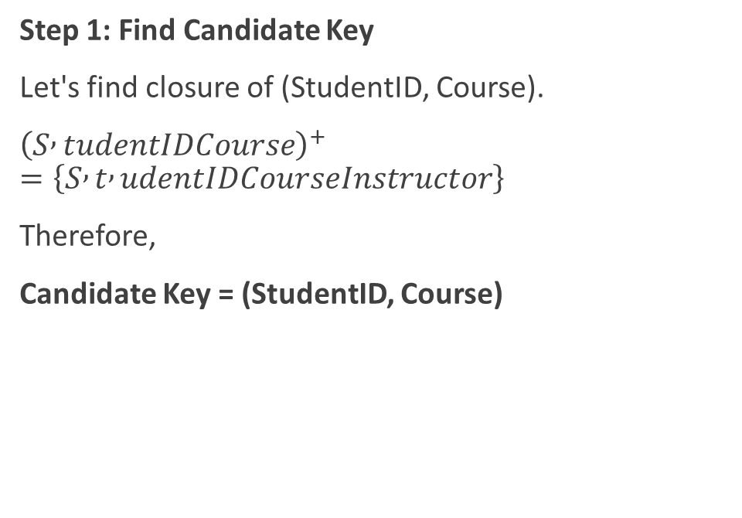
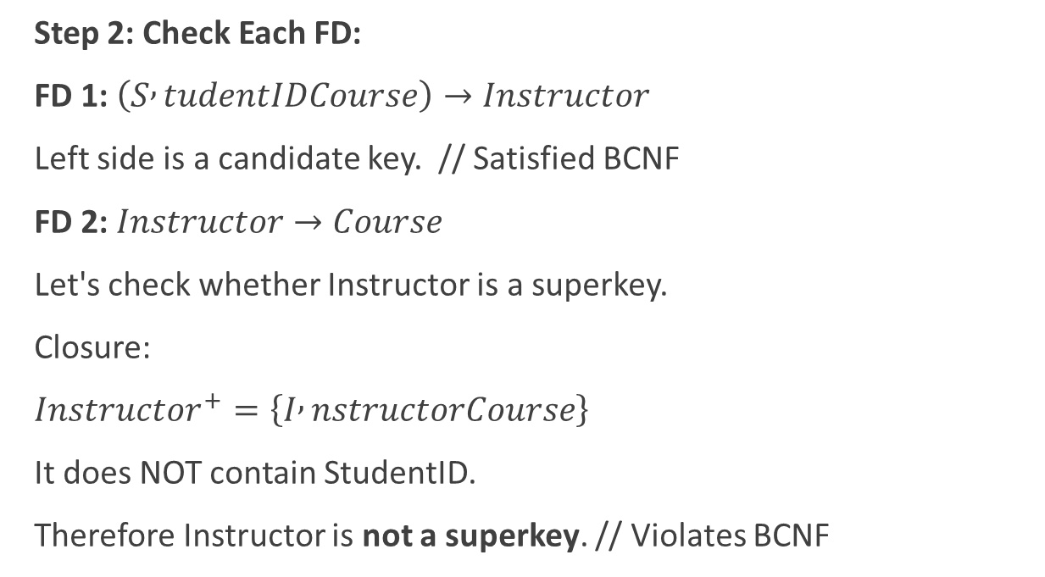
Step 1: Find Candidate Key
Let's find closure of (StudentID, Course).
${\left(S , tudentIDCourse\right)}^{+}=\left\{S , t , udentIDCourseInstructor\right\}$
Therefore,
Candidate Key = (StudentID, Course)
Step 2: Check Each FD:
FD 1: $\left(S , tudentIDCourse\right)→Instructor$
Left side is a candidate key. // Satisfied BCNF
FD 2: $Instructor→Course$
Let's check whether Instructor is a superkey.
Closure:
$Instructor^{+}=\left\{I , nstructorCourse\right\}$
It does NOT contain StudentID.
Therefore Instructor is not a superkey. // Violates BCNF
Notes:
What is the Mistake?
Look at the table:
InstructorCourseRamDBMSRamDBMSRamDBMSHariAIHariAI
Notice that Course information is repeated many times.
Redundancy Problem
If Ram teaches DBMS, we are storing that fact repeatedly for every student.
Update Anomaly
Suppose Ram starts teaching "Advanced DBMS".
We must update every row containing Ram.
StudentIDCourseInstructorS1Advanced DBMSRamS2DBMSRamS5DBMSRam
Now the database becomes inconsistent.
Insertion Anomaly
Suppose a new instructor "Shyam" will teach Networks but no student has enrolled yet.
Can we insert:
StudentIDCourseInstructor?NetworksShyam
No, because StudentID is required.
❌ Cannot store instructor-course information independently.
Deletion Anomaly
Suppose S4 is the only student enrolled in AI.
StudentIDCourseInstructorS4AIHari
If we delete S4:
DELETE FROM Teaching WHERE StudentID='S4';
Information that Hari teaches AI is lost.
❌ Deletion anomaly

Slide 78

Solution
InstructorCourse
Instructor | Course
Ram | DBMS
Hari | AI
Split the table into:
Check for BCNF again:
InstructorCourse: FD:
$Instructor→Course$
Instructor is the key.
In BCNF
StudentInstructor: No non-key determinant exists.
Key:$\left(S , tudentIDInstructor\right)$
In BCNF
StudentInstructor
StudentID | Instructor
S1 | Ram
S2 | Ram
S3 | Hari
S4 | Hari
S5 | Ram
Notes:
Examination-Oriented Definition
A relation is in Boyce-Codd Normal Form (BCNF) if for every non-trivial functional dependency $X→Y$, the determinant $X$is a superkey of the relation.
$$X→Y$$
Shortcut for Exams
Ask these two questions:
What are the candidate keys?
Is the left side of every FD a superkey?
If YES → BCNF.
If NO → Not BCNF and decomposition is required.
A common exam question is:
R(A, B, C), F = {A → B, B → C}
Candidate Key = A
B → C violates BCNF because B is not a superkey.
Decompose into:
R₁(B, C)
R₂(A, B)
This is the standard BCNF decomposition procedure used in university exams

Slide 79
Fourth Normal Form (4NF)
Stu_ID | Subject | Language
S101 | DBMS | English
S101 | DBMS | Nepali
S101 | OS | English
S101 | OS | Nepali
S102 | DBMS | English
S102 | CN | English
Rule:
Remove Multi-Valued Dependencies.
Assume: Student independently:
studies many subjects
knows many languages
Dependencies:
Student_ID ↠ Subject Student_ID ↠ Language
Subjects and languages are unrelated.
This causes unnecessary combinations.
Enrollment table
Student_Subject table
Student_language table
Stu_ID | Subject
S101 | DBMS
S101 | DBMS
S101 | OS
S101 | OS
Stu_ID | Language
S101 | English
S101 | Nepali
S101 | English
S101 | Nepali

Slide 80
Fifth Normal Form (5NF)
Stu_ID | Subject | Projects
S101 | DBMS | P1
S101 | OS | P2
S102 | DBMS | P1
S102 | CN | P3
Rule:
Remove Join Dependencies.
Assume: College Additionally Stores
A complex dependency may exist between:
Student
Subject
Project
The original relation can be
reconstructed through joins.
This removes redundancy
caused by join dependencies.
The table can be decomposed into 3 firther tables
Enrollment table
Student_language table
Subject_project table
Student_Subject table
Stu_ID | Projects
S101 | P1
S101 | P2
S102 | P1
S102 | P3
Subject | Projects
DBMS | P1
OS | P2
CN | P3
Stu_ID | Subject
S101 | DBMS
S101 | OS
S102 | CN

Slide 81
AT last, we get:
STUDENT
Student_ID | Student_Name | Dept_ID
STUDENT_SUBJECT
Dept_ID | Dept_Name
DEPARTMENT
Dept_ID | Dept_Name
STUDENT_LANGUAGE
DEPARTMENT
Dept_ID | Dept_Name
Dept_ID | Dept_Name
STUDENT_PROJECT
SUBJECT
Dept_ID | Dept_Name
Dept_ID | Dept_Name
TEACHER
Sujbect_Project
Dept_ID | Dept_Name
Dept_ID | Dept_Name

Slide 82
De-normalization for Performance
De-normalization is the process of intentionally adding redundancy (duplicate data) into a normalized database to improve query performance and reduce the number of joins required.
In normalization, we split tables to eliminate redundancy and anomalies.
In de-normalization, we merge tables or duplicate data to make data retrieval faster.
Normalization is ideal for data consistency, but in large systems joins can become expensive.
De-normalization is used when:
Faster Query Performance
Reduce Complex Joins
Improve Reporting and Analytics
Data Warehousing
Normalization saves storage and improves consistency.
De-normalization sacrifices some storage and consistency to gain speed.
Notes:
Normalization is ideal for data consistency, but in large systems joins can become expensive.
De-normalization is used when:
1. Faster Query Performance
Suppose an e-commerce site has millions of orders.
Every page load requiring 5–10 joins can be slow.
By storing frequently used information together, retrieval becomes faster.
Example
Instead of:
Order → Customer → Address
Store customer name directly in Order table.
OrderID | CustomerName
2. Reduce Complex Joins
Multiple joins consume:
CPU
Memory
Disk I/O
De-normalization reduces these operations.
Before
Order JOIN Customer JOIN Product JOIN Supplier JOIN Category
After
Store frequently accessed fields together.
Fewer joins.
3. Improve Reporting and Analytics
Reports often require data from many tables.
Instead of joining every time, create a de-normalized reporting table.
Example
Sales Report Table
DateProductCustomerAmount
All information is already available.
Reports run much faster.
4. Data Warehousing
Most data warehouses use de-normalized structures such as:
Star Schema
Snowflake Schema (partially normalized)
Fact tables often contain redundant information for fast analysis.

Slide 83
Example: Find Student’s Department.
Using Normalized database.
SQL:
SELECT StudentName, DeptName FROM Student
JOIN Student_Department
ON Student.StudentID = Student_Department.StudentID
JOIN Department
ON Department.DeptID = Student_Department.DeptID;
StudentID | StudentName
101 | Ram
102 | Sita
DeptID | DeptName
D1 | Computer
D2 | Civil
StudentID | DeptID
101 | D1
102 | D2
Student Table
Department Table
Student_Department Table
De-normalized Database
StudentID | StudentName | DeptName
101 | Ram | Computer
102 | Sita | Civil
Student Table
SQL:
SELECT StudentName, DeptName
FROM Student;
Notes:
Normalization is ideal for data consistency, but in large systems joins can become expensive.
De-normalization is used when:
1. Faster Query Performance
Suppose an e-commerce site has millions of orders.
Every page load requiring 5–10 joins can be slow.
By storing frequently used information together, retrieval becomes faster.
Example
Instead of:
Order → Customer → Address
Store customer name directly in Order table.
OrderID | CustomerName
2. Reduce Complex Joins
Multiple joins consume:
CPU
Memory
Disk I/O
De-normalization reduces these operations.
Before
Order JOIN Customer JOIN Product JOIN Supplier JOIN Category
After
Store frequently accessed fields together.
Fewer joins.
3. Improve Reporting and Analytics
Reports often require data from many tables.
Instead of joining every time, create a de-normalized reporting table.
Example
Sales Report Table
DateProductCustomerAmount
All information is already available.
Reports run much faster.
4. Data Warehousing
Most data warehouses use de-normalized structures such as:
Star Schema
Snowflake Schema (partially normalized)
Fact tables often contain redundant information for fast analysis.

Slide 84
When should de-normalization be used?
Use de-normalization when:
Read operations are much more frequent than updates.
Query performance is more important than storage space.
Reporting and analytics require many joins.
Aggregate values are repeatedly calculated.
Avoid de-normalization when:
Data changes frequently.
Data consistency is critical.
The database is small and joins are inexpensive.

Slide 85
How is Denormalization done?
Method 1: Merge Tables
Before: Student table + Department table
Later: Student table with department information
Method 2: Duplicate Columns
Before: Customer table = CustomerId, Name
Later: Order table = OrderId, CustomerID, CustomerName // here customerName is duplicated.
Method 3: Store Calculated Values
Before: Quantity = 5, Price = 100, Yotal must be calculated in SQl as Quantity x Price
Denormalized: Store Quantity = 5, Price = 100, Total = 500. this lets faster retrival

Slide 86
Advantages and Disadvantages
Faster queries i.e. Less joining
Better read performance i.e. Quick data retrieval
Faster reporting i.e. Pre-computed data
Reduced join operations i.e. Less CPU usage
Useful in data warehouses i.e. Efficient analytics
Data redundancy i.e. Same data stored multiple times
More storage required i.e. Duplicate data occupies space
Update anomalies i.e. Must update data in many places
Data inconsistency risk i.e. Different copies may not match
More maintenance i.e. Synchronization becomes difficult

Slide 87
Case 1: Ecommerce Website
A common misconception is that de-normalization means "randomly merging tables."
In reality, de-normalization is a carefully planned optimization technique where data is duplicated or precomputed to improve performance.
To display orders:
SELECT O.OrderID, C.Name
FROM Orders O
JOIN Customer C
ON O.CustomerID = C.CustomerID;
Every order lookup requires a join.
CustomerID | Name
101 | Ram
OrderID | CustomerID
5001 | 101
OrderID | CustomerID | CustomerName
5001 | 101 | Ram
De-normalized Design
SELECT OrderID, CustomerName
FROM Orders; Hence No joins required..
Why?
An order is a historical record. Even if the customer later changes their name, many businesses want the original name preserved on the order.
Thus the duplicated data is actually useful.
Notes:
Case 2: Online Shopping Cart
Normalized
Product
ProductIDNamePriceP1Laptop1000
Cart
CartIDProductIDQty1P12
To display cart:
SELECT * FROM Cart JOIN Product;
Thousands of users may perform this query every second.
De-normalized
Cart
CartIDProductIDProductNamePriceQty1P1Laptop10002
No join needed.
Page loads faster.
Case 3: Student Management System
Suppose your university database contains:
Student
StudentIDNameDeptID101HariD1
Department
DeptIDDeptNameD1Computer
Every report requires:
Student JOIN Department
De-normalized
Student
StudentIDNameDeptIDDeptName101HariD1Computer
Now reports run faster.
Why Useful?
If thousands of student records are displayed every day, eliminating joins can significantly reduce query time.
Case 4: Storing Calculated Values
This is one of the most common forms of de-normalization.
Normalized
OrderItem
QtyPrice5100
Total is calculated each time:
Total = Qty × Price
De-normalized
OrderItem
QtyPriceTotal5100500
Total is stored.
No calculation needed.
Real Example
Food delivery apps:
Food price
Tax
Delivery charge
Discount
Final amount is often stored directly rather than recalculated every time.
Case 5: Social Media (Facebook/Instagram)
Normalized
Post
PostIDContent
Likes
LikeIDPostID
To display likes:
SELECT COUNT(*) FROM Likes WHERE PostID = 1;
For millions of posts, counting repeatedly becomes expensive.
De-normalized
Post
PostIDContentLikeCount1Hello1250
When someone likes the post:
LikeCount = LikeCount + 1
No need to count all likes again.
Real Systems
Most social media platforms store:
LikeCount
CommentCount
ShareCount
ViewCount
These are de-normalized fields.
Case 6: Banking Statements
Normalized
Customer
CustomerIDName
Transaction
TransactionIDCustomerID
Statement generation requires joins.
De-normalized
Transaction
TransactionIDCustomerIDCustomerName
Historical transactions remain intact even if customer details change later.

Slide 88
Open-book test 3 questions
Question 1: Integrity Constraints Analysis:
A university database contains the following tables:Student(StudentID, Name, Email, DeptID)
Department(DeptID, DeptName) Identify and explain:
Domain Constraints
Entity Integrity Constraints
Referential Integrity Constraints
for the above schema.Further, discuss what inconsistencies may arise if these constraints are violated.
Question 2: Functional Dependencies and Armstrong's Axioms: Consider the relation: R(A, B, C, D, E) with Functional Dependencies:
A → BC
B → D
CD → E
Using Armstrong's Axioms, derive:
A → D , A → E
Show all intermediate steps and specify which axiom is used at each step.

Slide 89
Open-book test 3 questions
Question 3: Closure and Candidate Keys: Consider: R(A, B, C, D, E, F)
Functional Dependencies:
A → BC
B → D
CD → E
E → F
Tasks:
Find A⁺.
Determine whether A is a candidate key.
Identify all candidate keys if any exist.
Explain the role of attribute closure in candidate key identification.
Notes:
Question 4: Normalization Case Study
An online bookstore maintains the following relation:
OrderIDCustomerNameCustomerAddressBookIDBookTitleQuantity
Analyze the relation and:
Identify redundancy issues.
Discuss possible insertion, deletion, and update anomalies.
Convert the relation into:
1NF
2NF
3NF
Justify each decomposition.
Question 5: BCNF Evaluation
Given:
R(StudentID, CourseID, Instructor)
Functional Dependencies:
StudentID, CourseID → Instructor
Instructor → CourseID
Tasks:
Determine the candidate keys.
Check whether the relation is in:
1NF
2NF
3NF
BCNF
If BCNF is violated, perform BCNF decomposition and explain why.
Question 6: De-normalization for Performance
A large e-commerce platform stores:
Customer(CustomerID, Name, Email)
Orders(OrderID, CustomerID, OrderDate)
The reporting team frequently generates reports containing:
OrderID
CustomerName
CustomerEmail
OrderDate
Tasks:
Explain the joins required in the normalized design.
Propose a de-normalized design.
Discuss performance benefits.
Analyze possible risks and consistency issues introduced by de-normalization.
Recommend whether de-normalization should be implemented and justify your answer.

Slide 90
Is BCNF always better than 3NF? Justify your answer with examples.
Can de-normalization be considered the opposite of normalization?
Explain critically. Why can a relation be in 3NF but not in BCNF?
How do Functional Dependencies guide the normalization process?
In modern distributed databases, why might designers intentionally violate normalization principles?
Compare database triggers and application-level validation in maintaining data integrity.

Slide 91
Conceptual Questions
Why are integrity constraints necessary in a database system? What problems can occur if they are not enforced?
Differentiate between Domain Constraints, Entity Integrity Constraints, and Referential Integrity Constraints with suitable examples.
Why must a primary key never contain NULL values? Explain from the perspective of Entity Integrity.
Consider a university database where a student record references a department record. Explain how Referential Integrity maintains consistency between the two tables.
Triggers are often called event-driven procedures. Justify this statement with examples.
What characteristics make a relational database design "good"? Explain the consequences of poor database design.
Why are Functional Dependencies important in database design and normalization?
Differentiate between: Closure of Functional Dependencies (F⁺) , Closure of Attribute Sets (X⁺) , Why are both important?
How can attribute closure be used to identify candidate keys?
What kinds of anomalies can occur in a non-normalized database? Explain with examples.
Why is de-normalization considered both beneficial and risky? Explain situations where de-normalization is preferred over normalization.

